Slide 1
Using InSAR and GNSS for tectonic research
With contributions from GETSI-SERC and UNAVCO

Slide 2
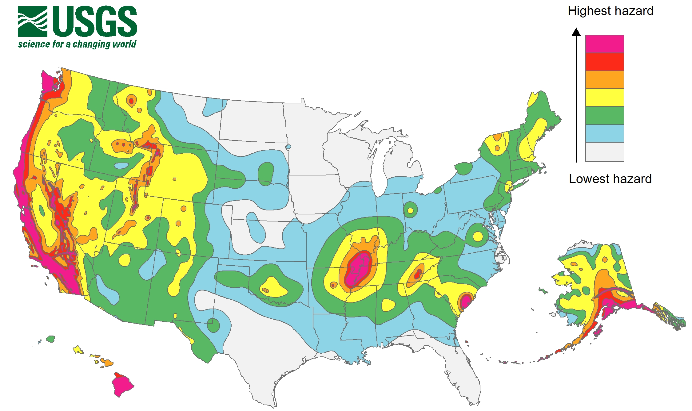
Coming Soon to a City near you…

Slide 3
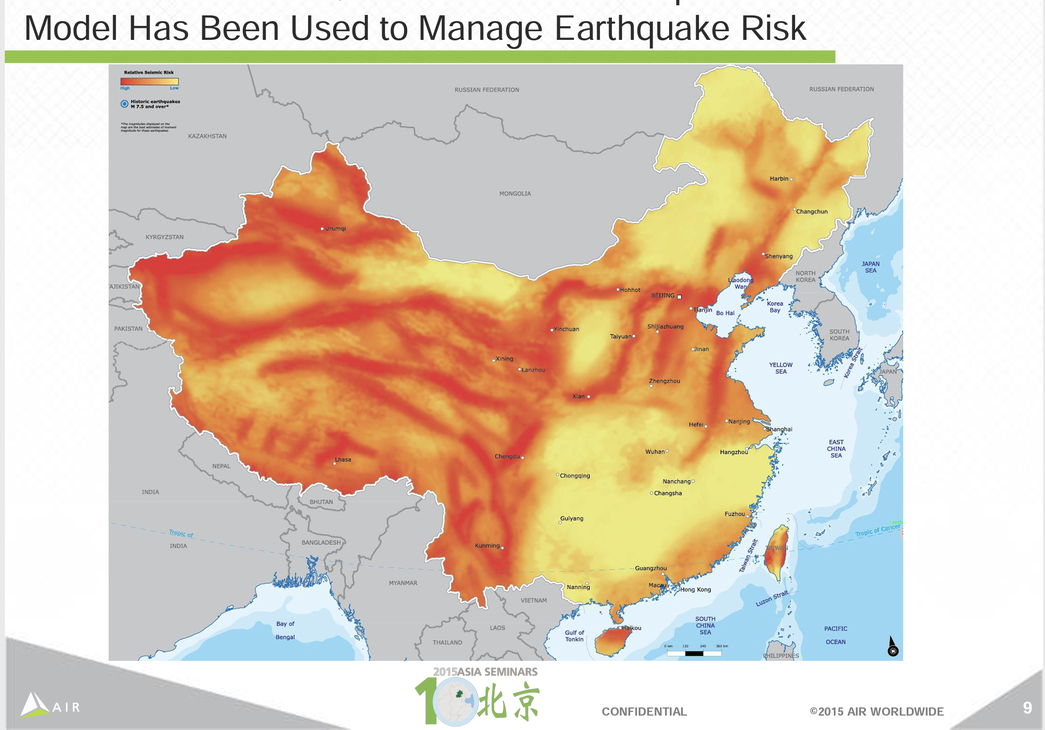

Slide 4
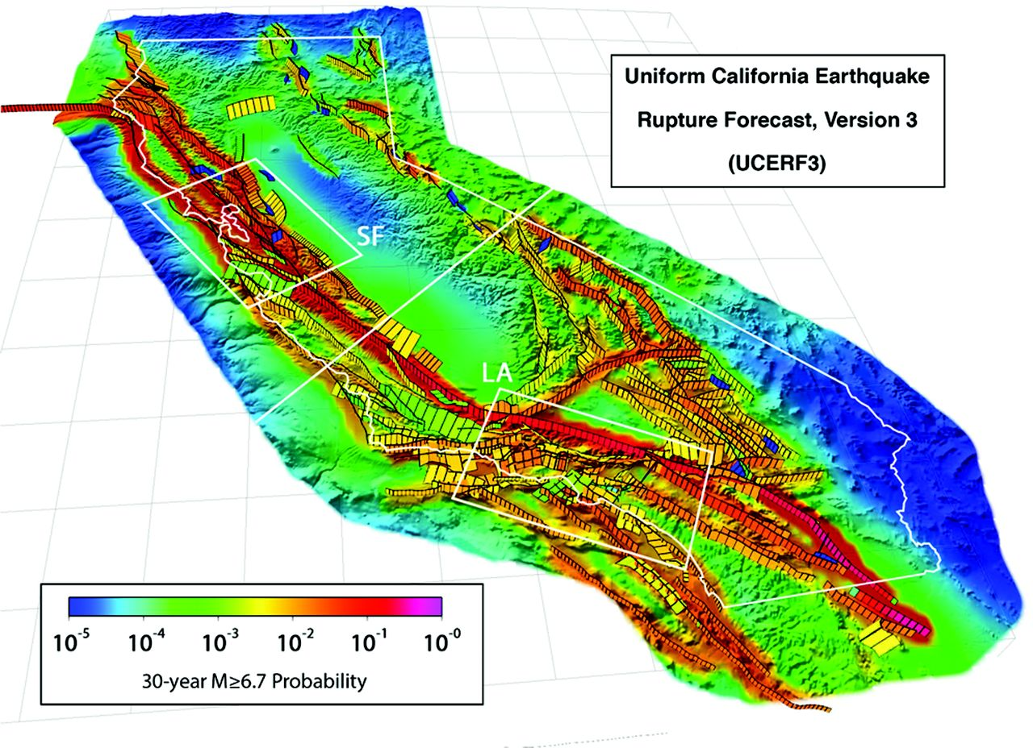
Coming soon to a city near you…
Sources of Data for forecasting the long-term earthquake hazard:
Historical seismicity
Paleoseismology
Interseismic strain accumulation
Field et al., 2014 (UCERF3)
Notes:
Punchline at the beginning → take-home message
Don’t say “you may not kwow…”
Paleoseism – limited places with conti. Depo. And dif interp

Slide 5
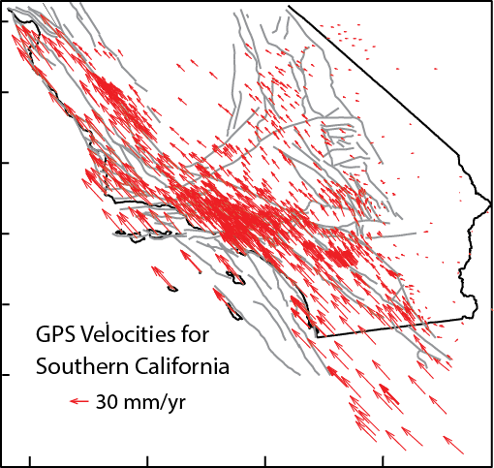
Coming soon to a city near you…
Sources of Data for forecasting the long-term earthquake hazard:
Historical seismicity
Paleoseismology
Interseismic strain accumulation
Field et al., 2014 (UCERF3)
Notes:
Punchline at the beginning → take-home message
Don’t say “you may not kwow…”
Paleoseism – limited places with conti. Depo. And dif interp

Slide 6
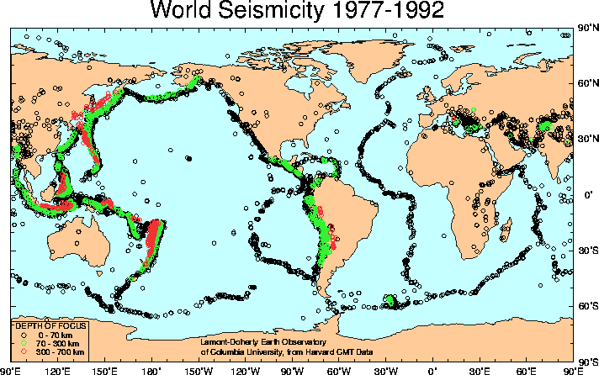
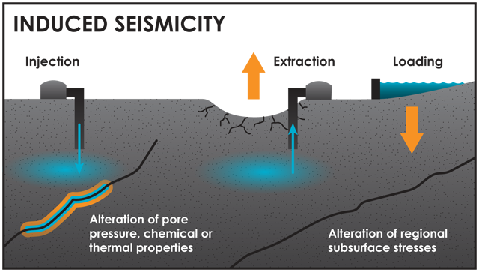
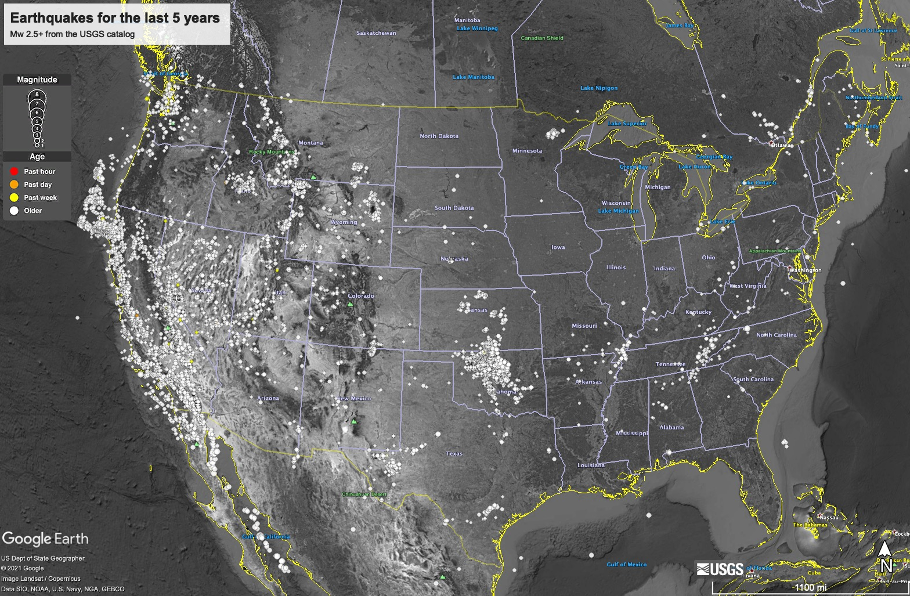

Most large earthquakes occur near plate boundaries due to tectonic motion, but earthquakes can occur almost anywhere due to both natural and anthropogenic forces
www.ldeo.columbia.edu/LCSN/Eq/Global/seismicity.html

Slide 7
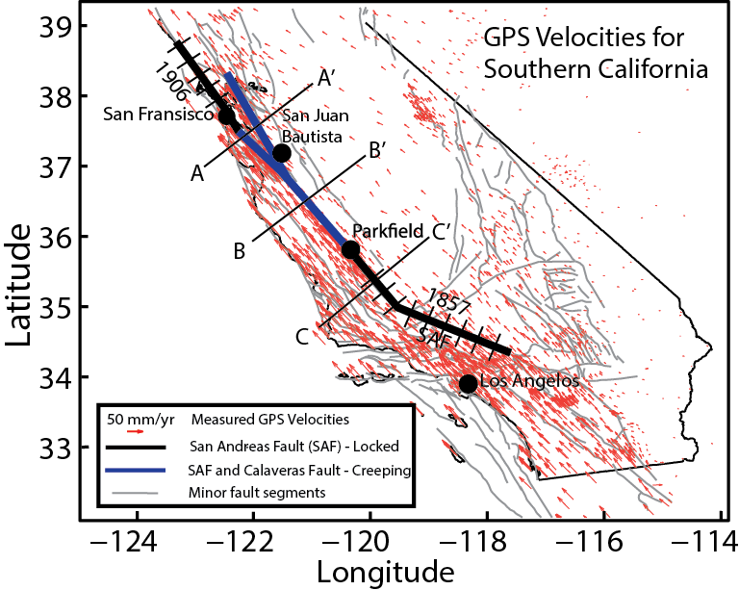
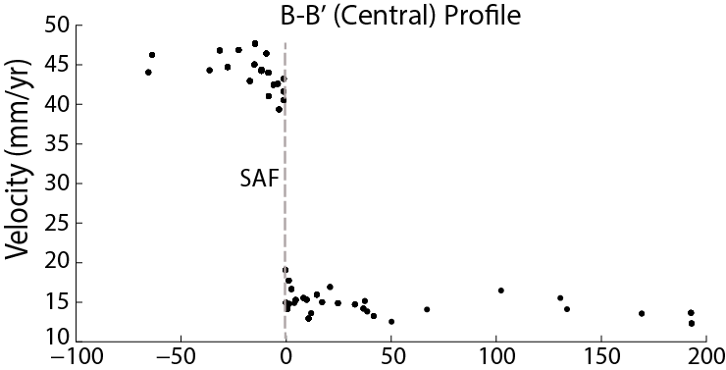
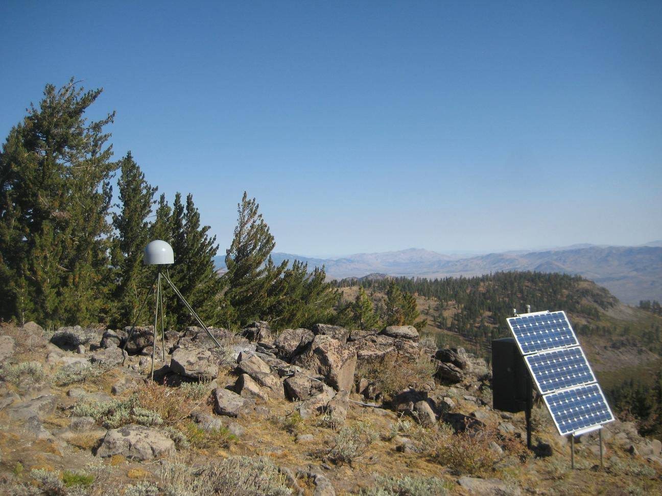
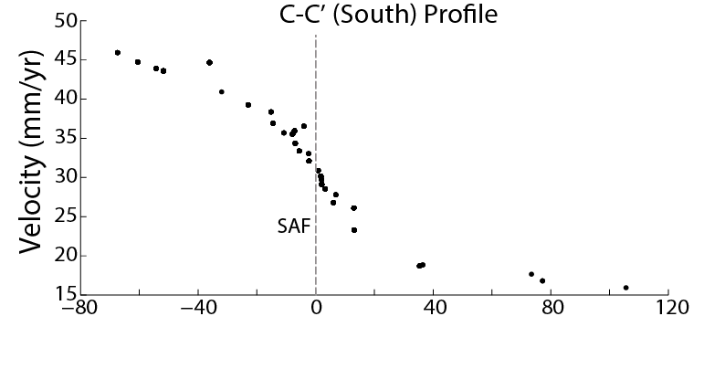
Geodesy - Global Navigation Satellite Systems (GNSS)
Source: http://geodesy.unr.edu/
Source: https://serc.carleton.edu/getsi/geodesy

Slide 8
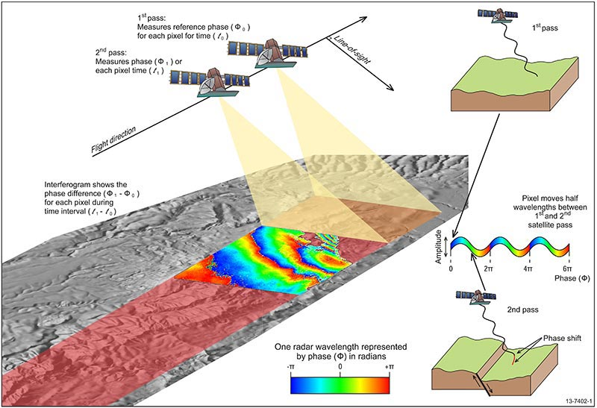
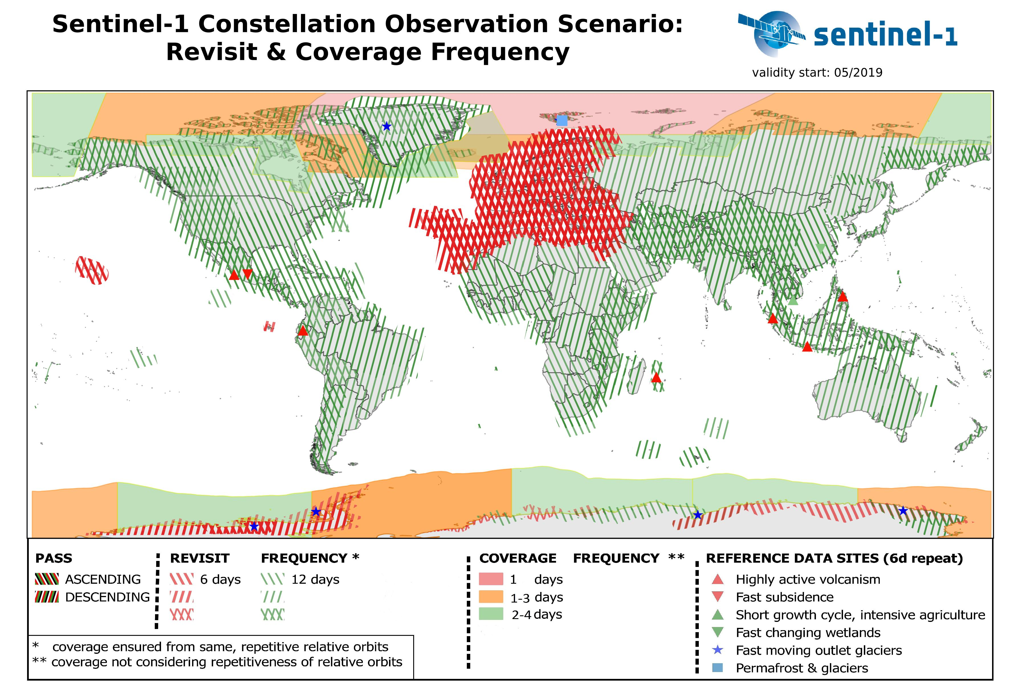
Interferometric Synthetic Aperture RADAR (InSAR)
Current and upcoming SAR missions provide:
12 or 6-day repeat time coverage of the entire globe
5-20 meter maximum resolution
Day and night, all-weather observations

Slide 9
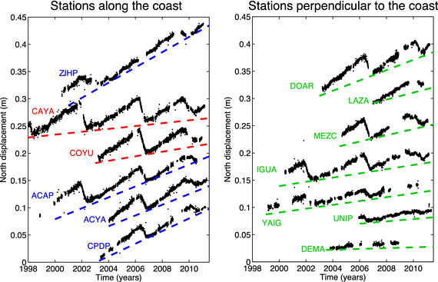
Steps in using GNSS for tectonics
Access GNSS time-series or process raw GNSS observations to time-series
Determine which deformation component is of interest (coseismic, interseismic, postseismic, etc.)
Extract the relevant displacements or velocities from the time-series

Slide 10
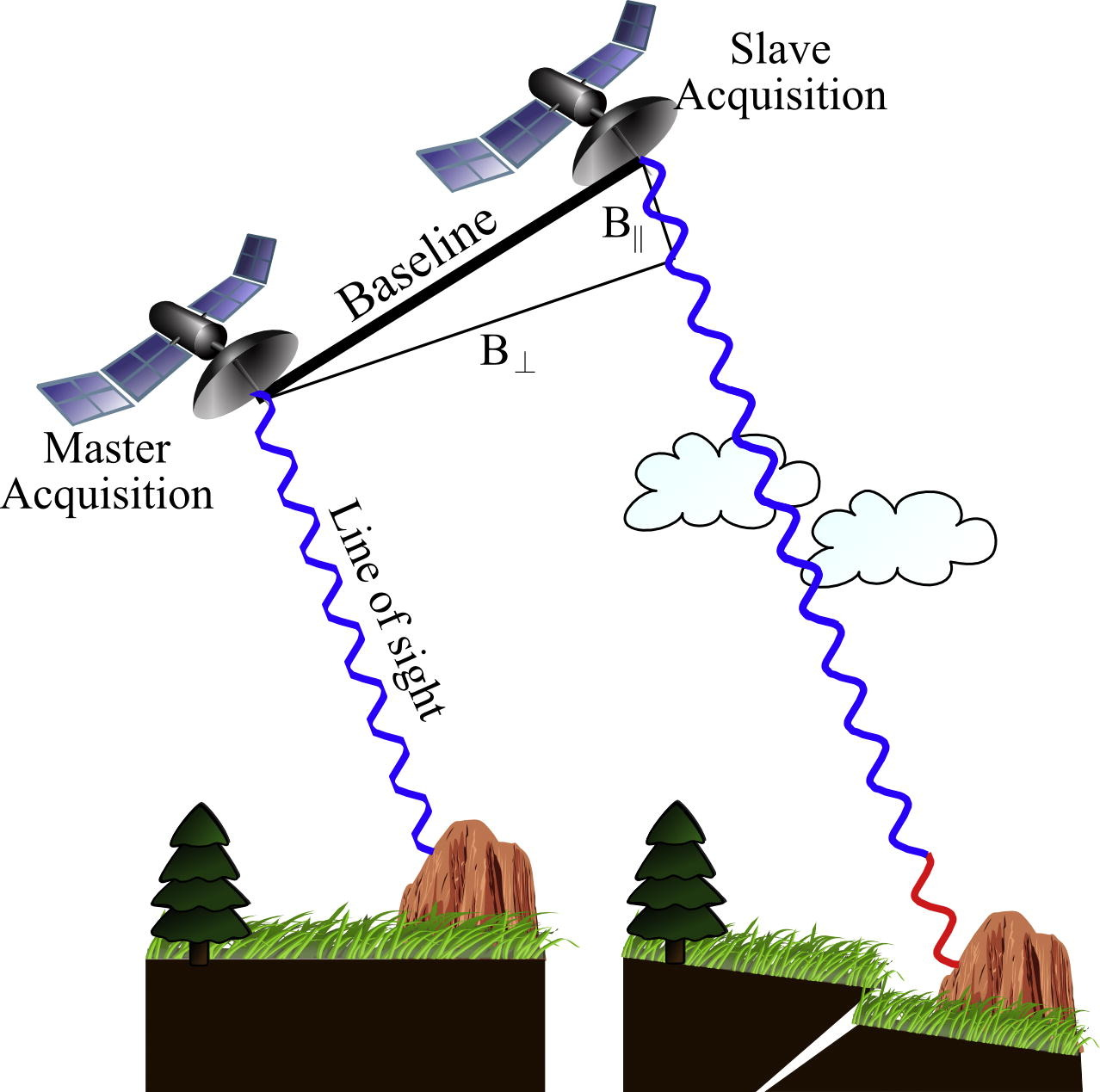
Steps in using InSAR for tectonics
Process raw SAR observations to InSAR (interferograms)
Use interferograms to solve for time-series
Osmanoğlu et al., 2016
https://www.ga.gov.au/

Slide 11
Steps in using InSAR for tectonics
Process raw SAR observations to InSAR (interferograms)
Use interferograms to solve for time-series
Displacement
Time

Slide 12
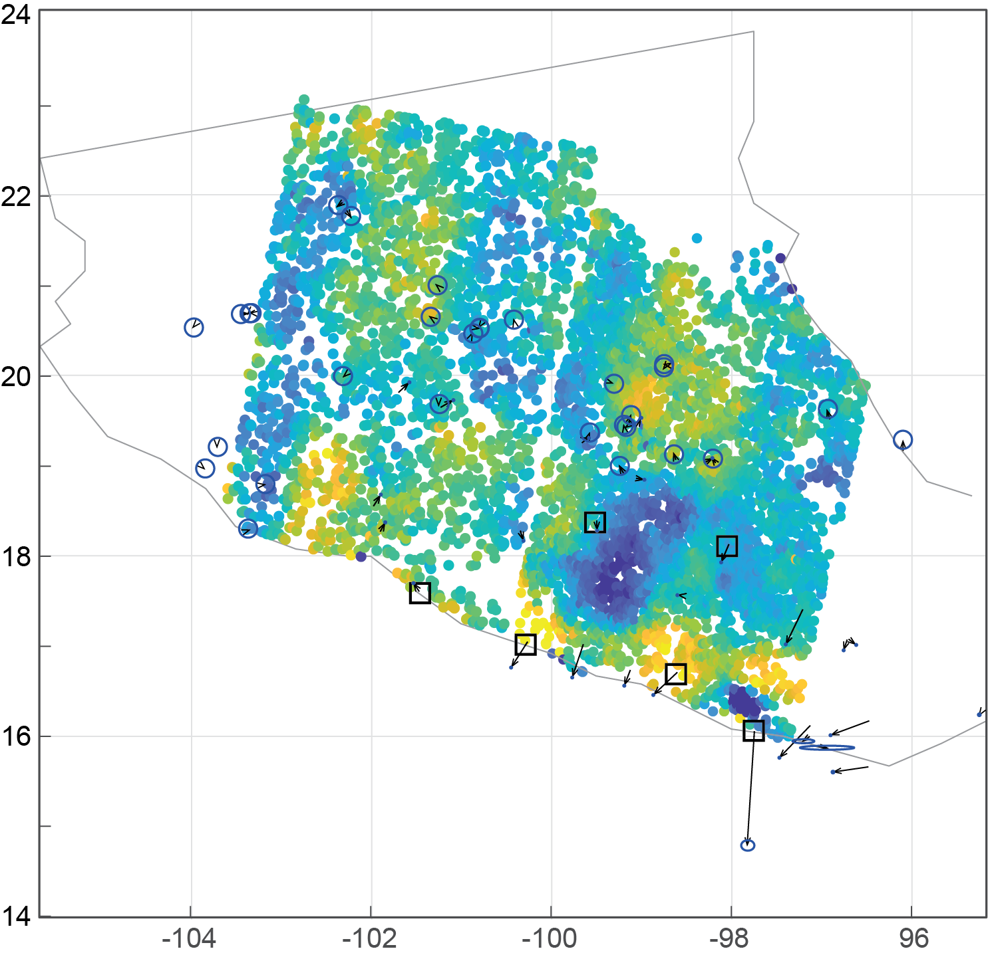
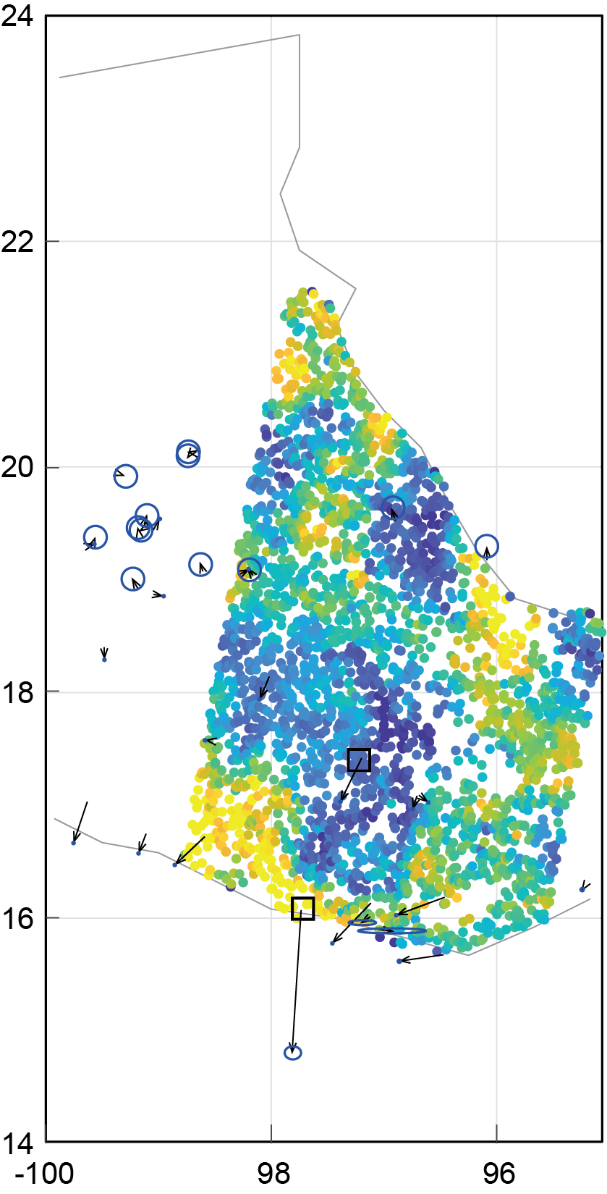
Steps in using InSAR for tectonics
Process raw SAR observations to InSAR (interferograms)
Use interferograms to solve for time-series
Determine which deformation component is of interest (coseismic, interseismic, postseismic, etc.)
Extract the relevant displacements or velocities from the time-series

Slide 13
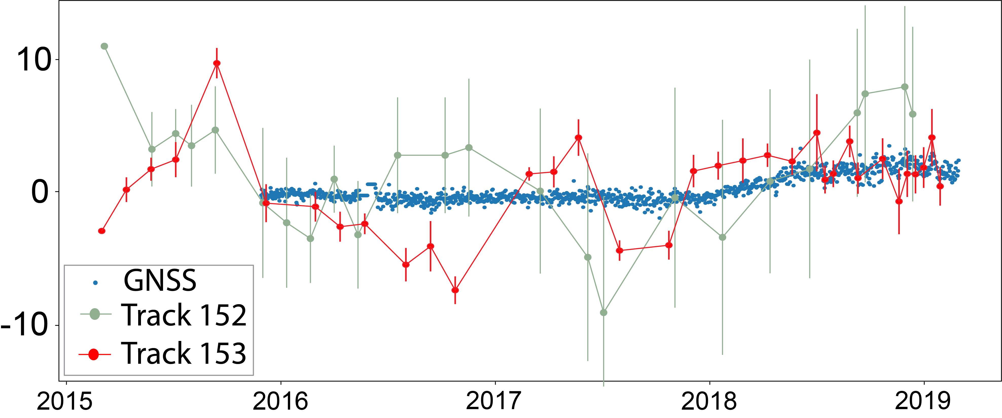
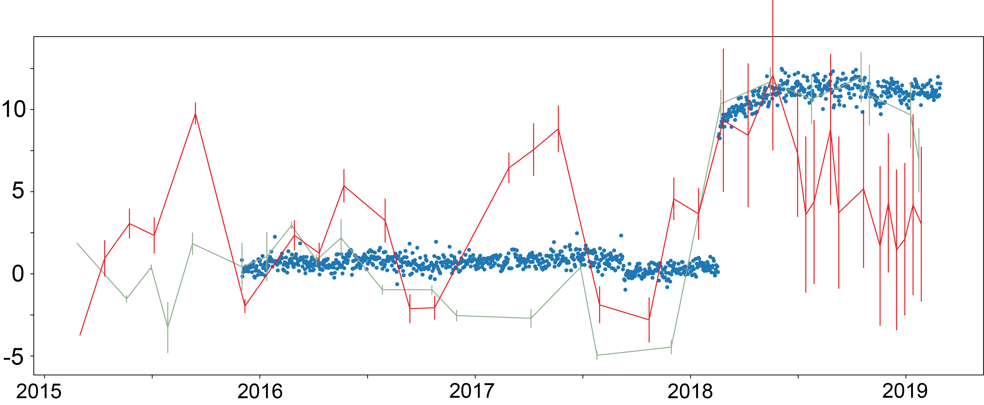
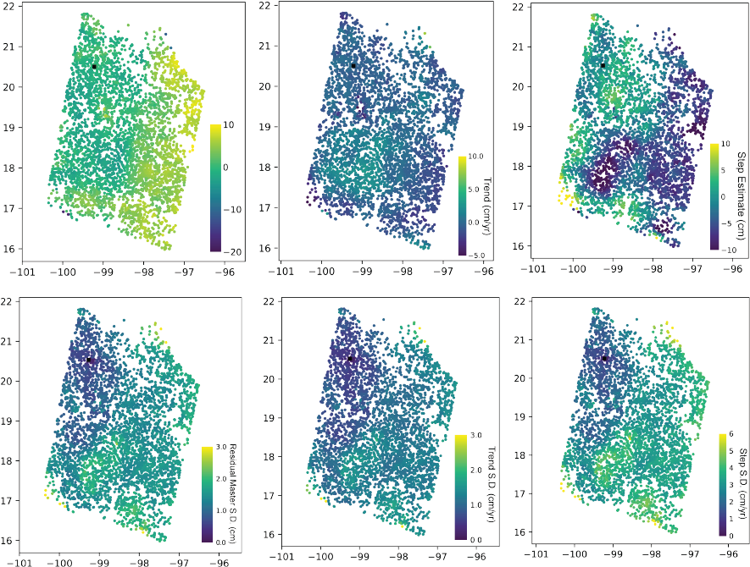
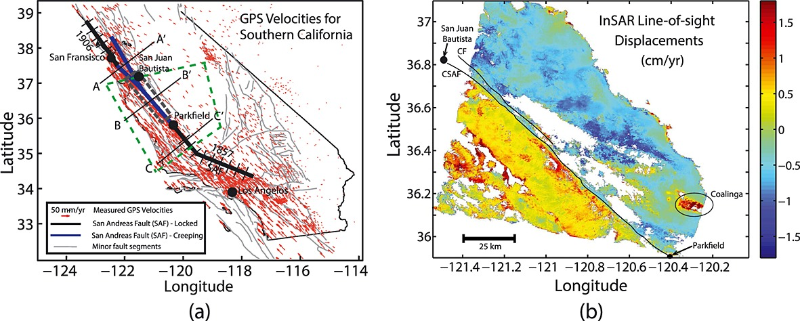
Comparing and Combining measurement types
Track 155
Track 153
Track 152
10 cm
Step
-10 cm
Building accurate noise models
Quantifying the spatial correlation structure of the observations and the noise
Identifying biases, accounting for sensitivities

Slide 14
Earthquake cycle deformation and strain rate

Slide 15
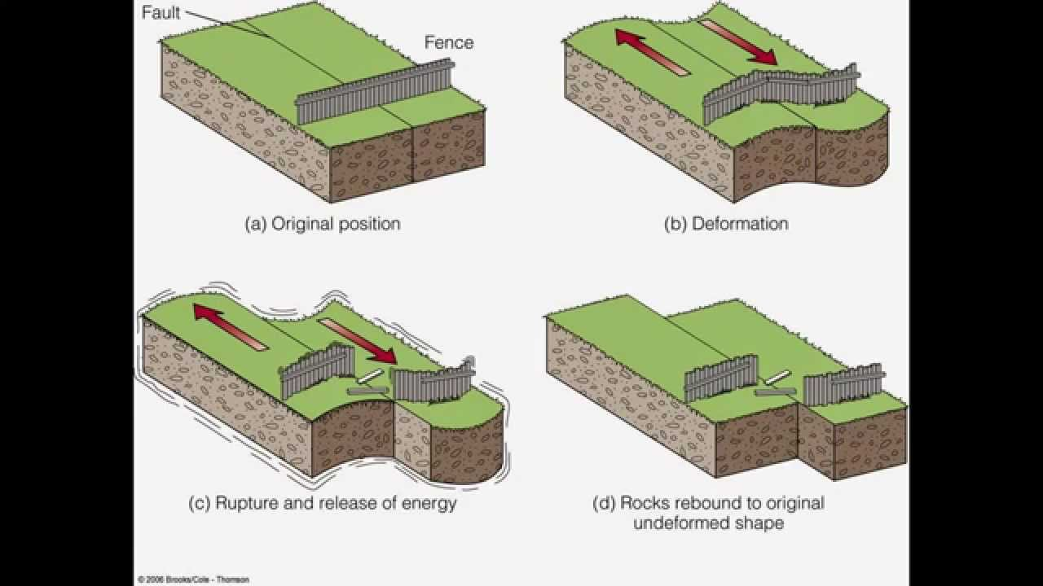
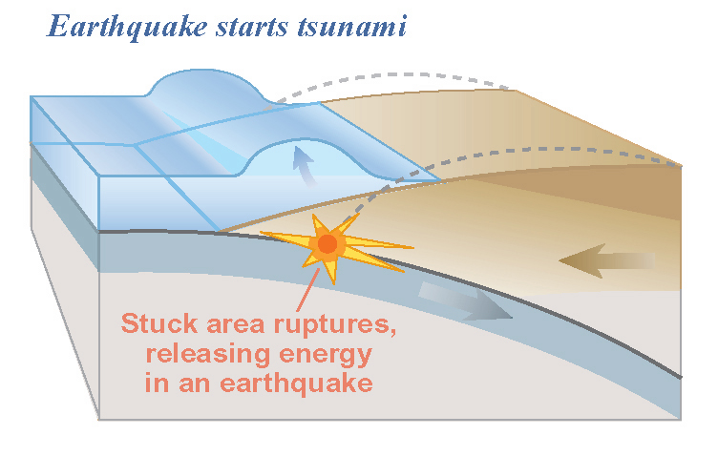
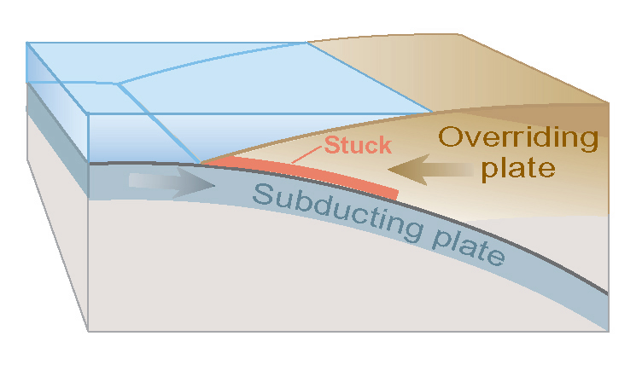
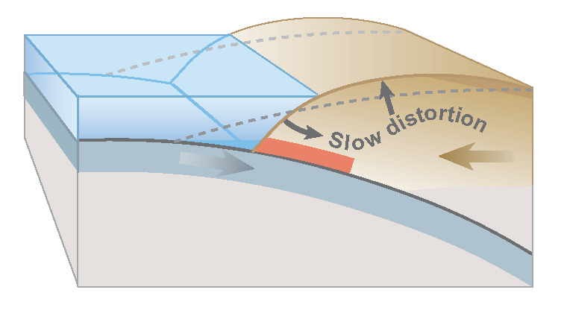
Geodesy measures crustal motions from earthquakes
Actively creeping fault
Locked Fault accumulating strain
Interseismic loading
Interseismic surface deformation
Earthquake
Modified from Atwater

Slide 16
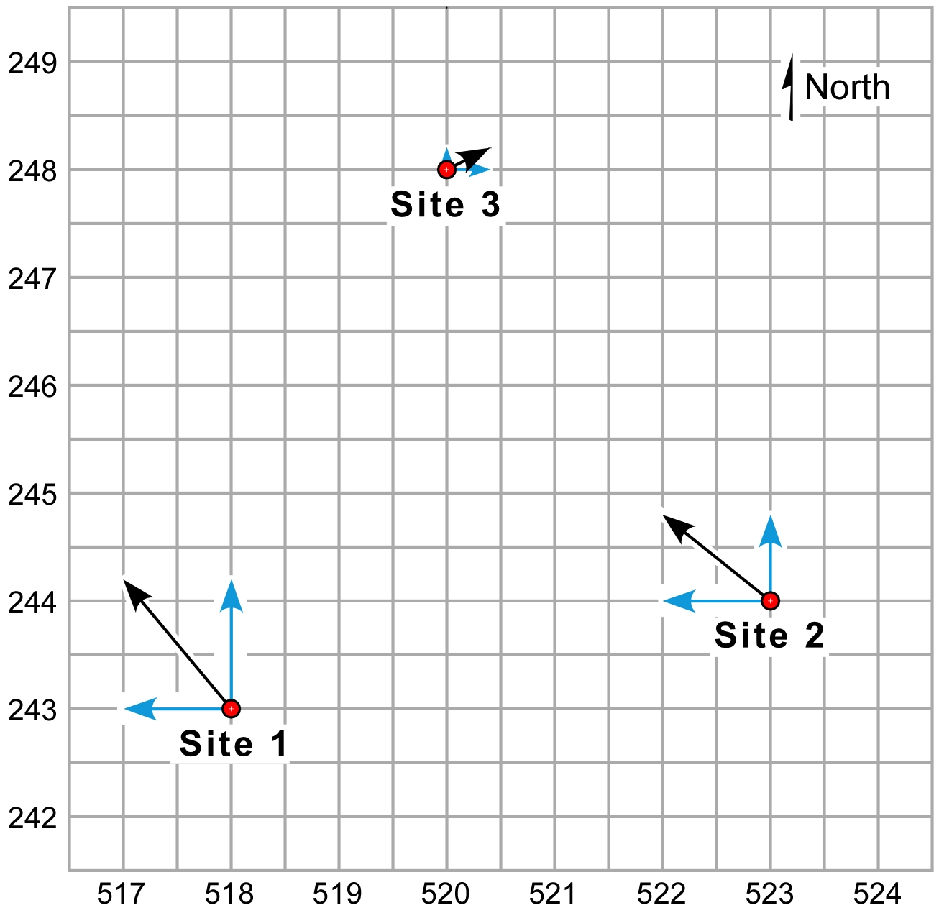
Strain rates from GNSS
E-W + N-S components = total site velocity

Slide 17
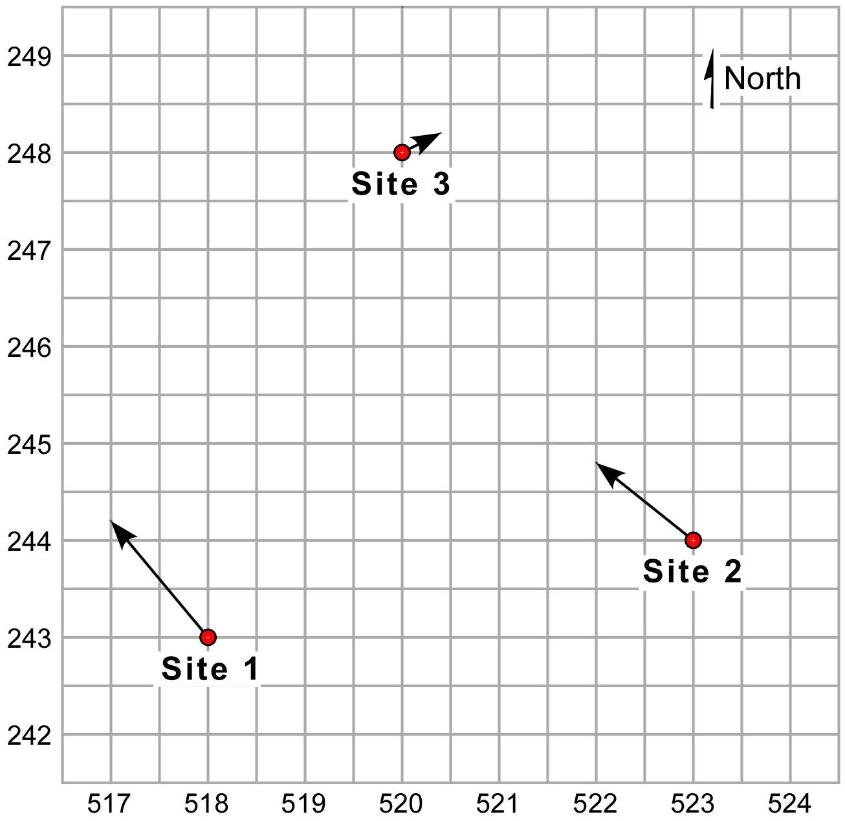
Strain rates from GNSS
Total site velocities

Slide 18
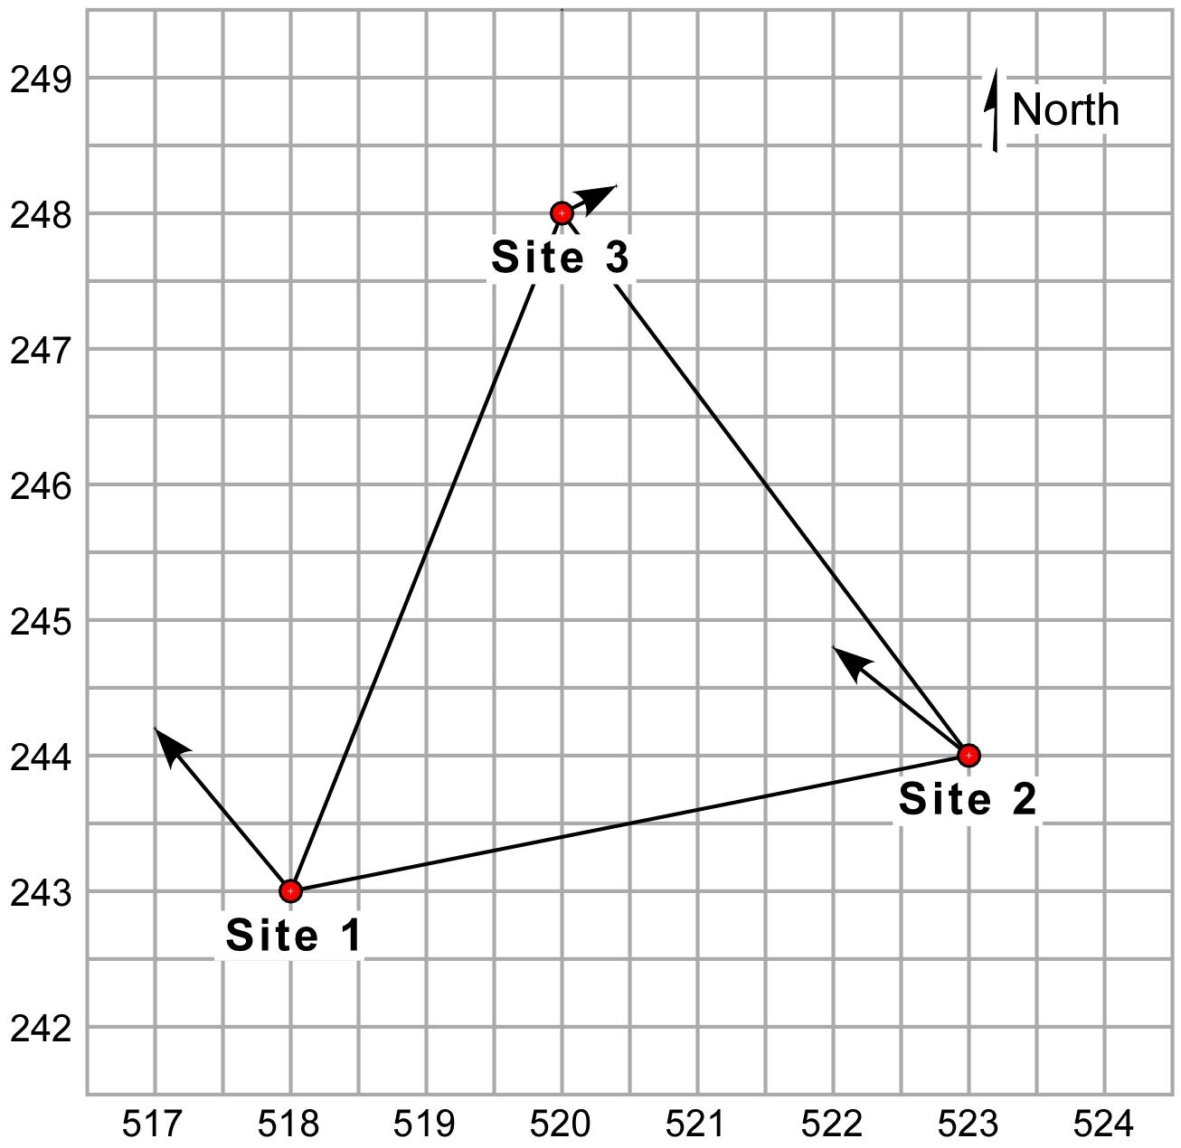
Strain rates from GNSS
Define the triangle between the GPS sites

Slide 19
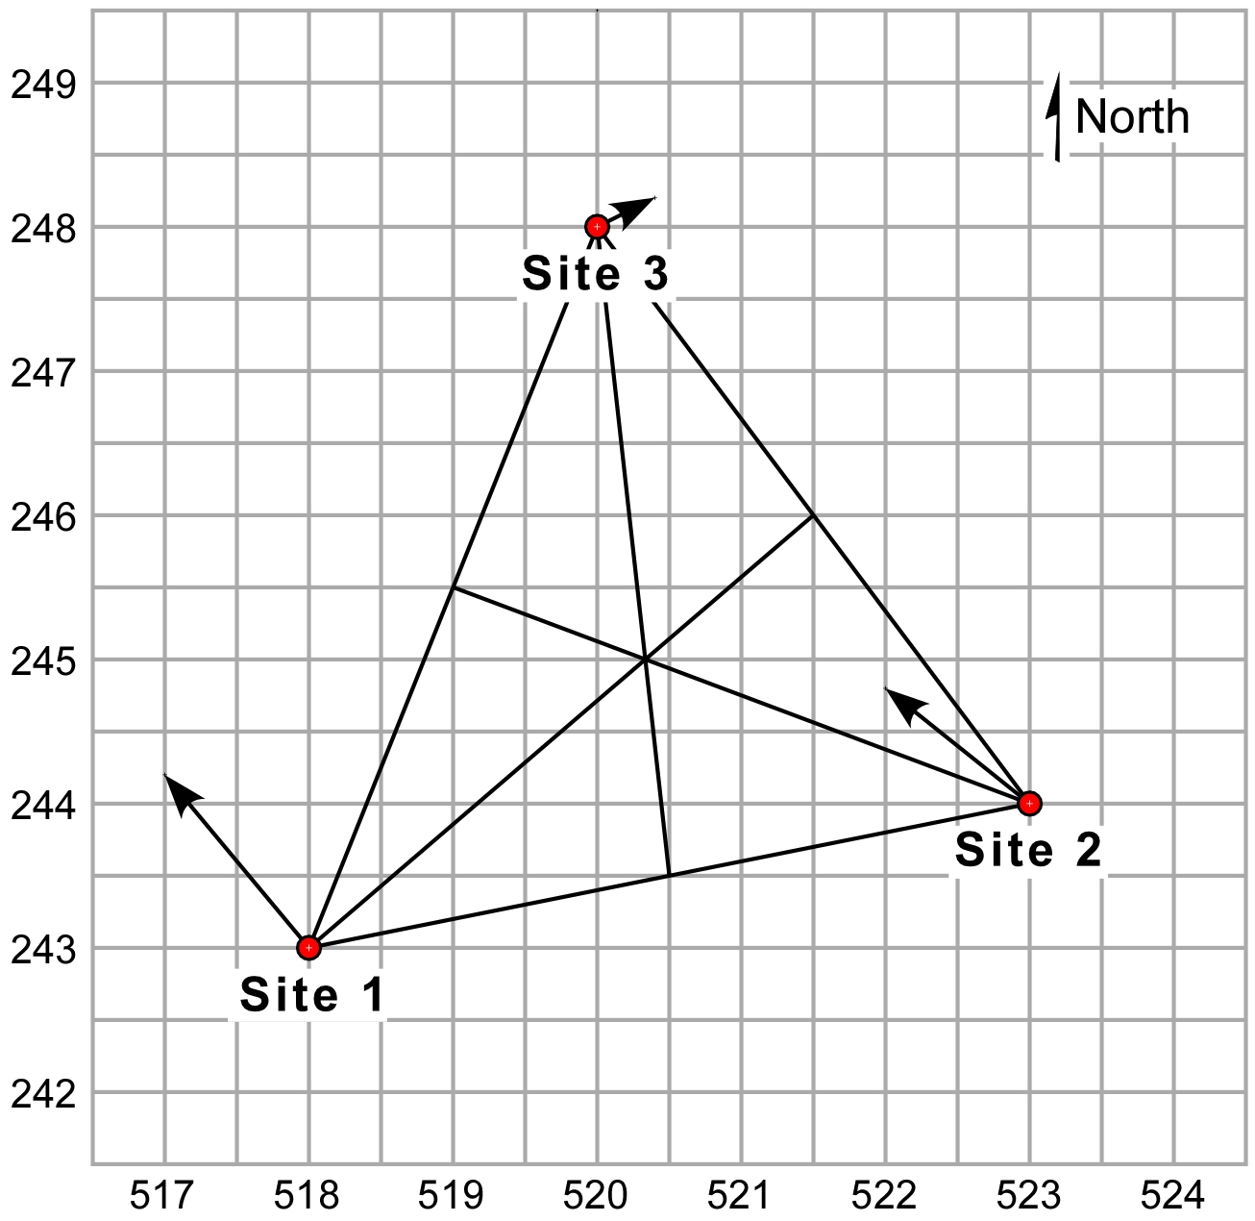
Strain rates from GNSS
Define the centroid of the triangle

Slide 20
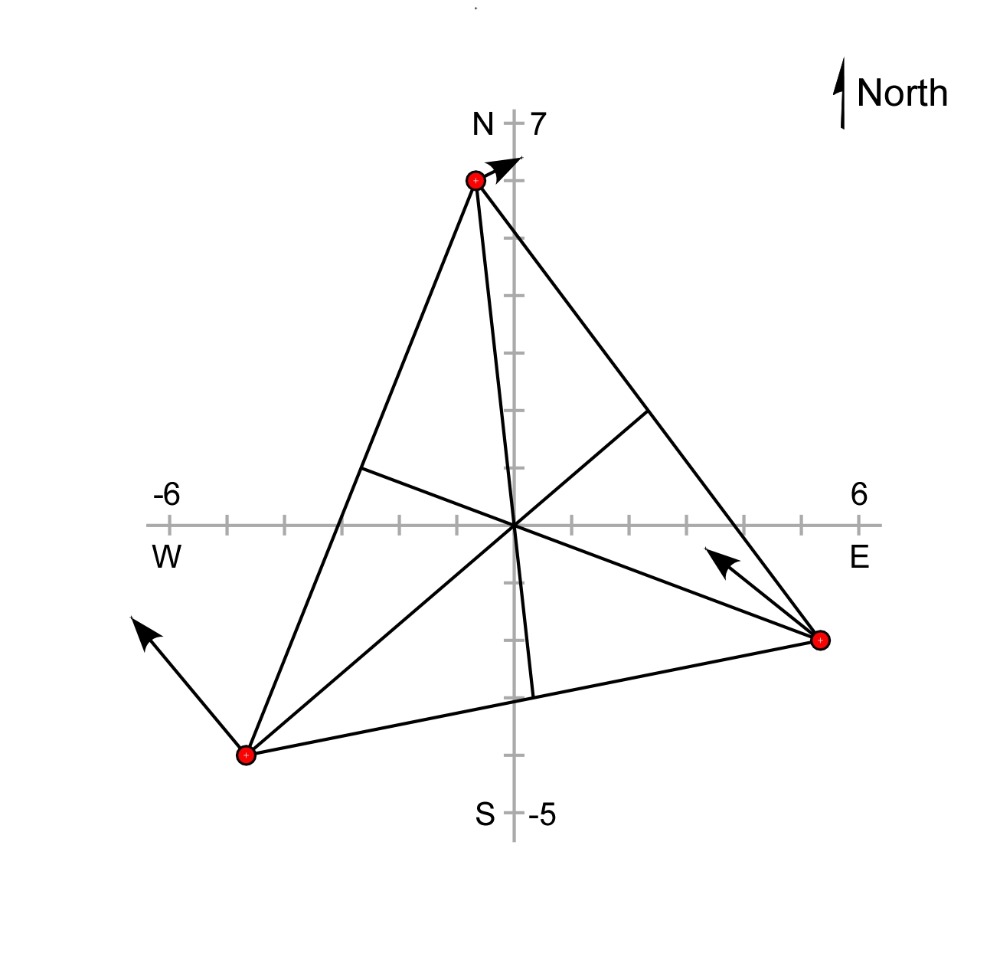
Strain rates from GNSS
Transform coordinate system to a new origin at the centroid of the triangle

Slide 21
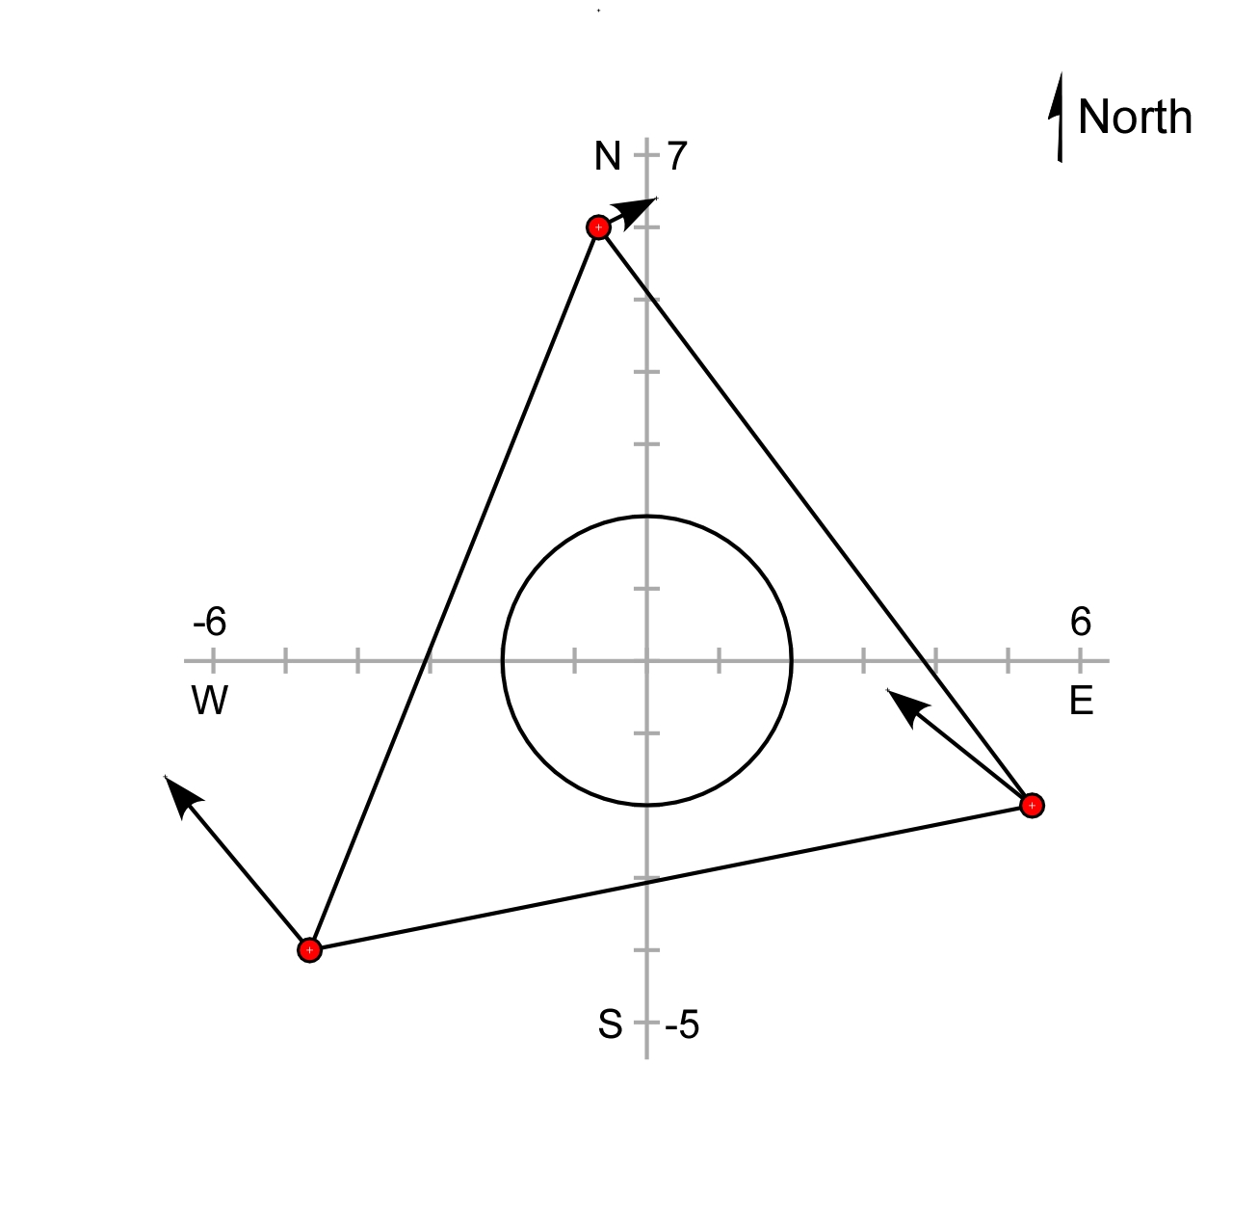
Strain rates from GNSS
Inscribe a circle in the center of the undeformed triangle

Slide 22
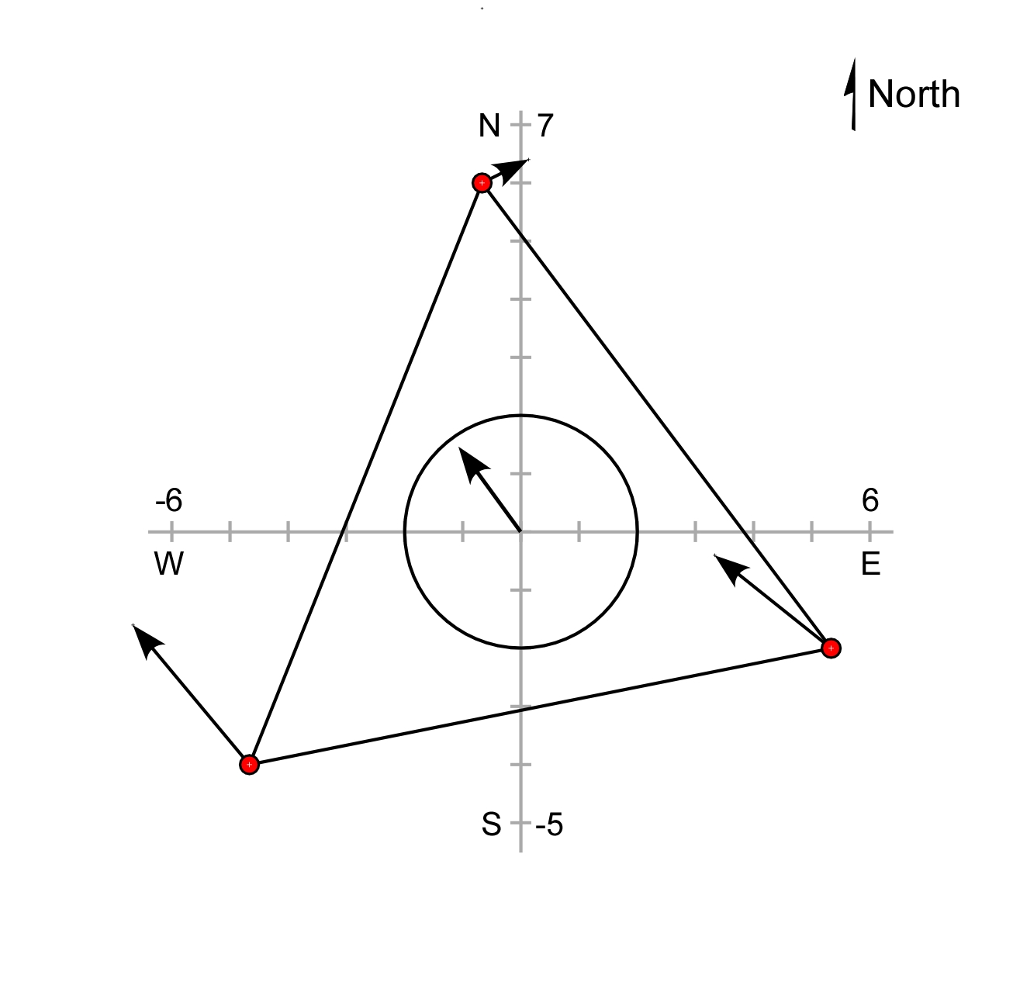
Strain rates from GNSS
The average of the three total site velocities is the translation vector

Slide 23
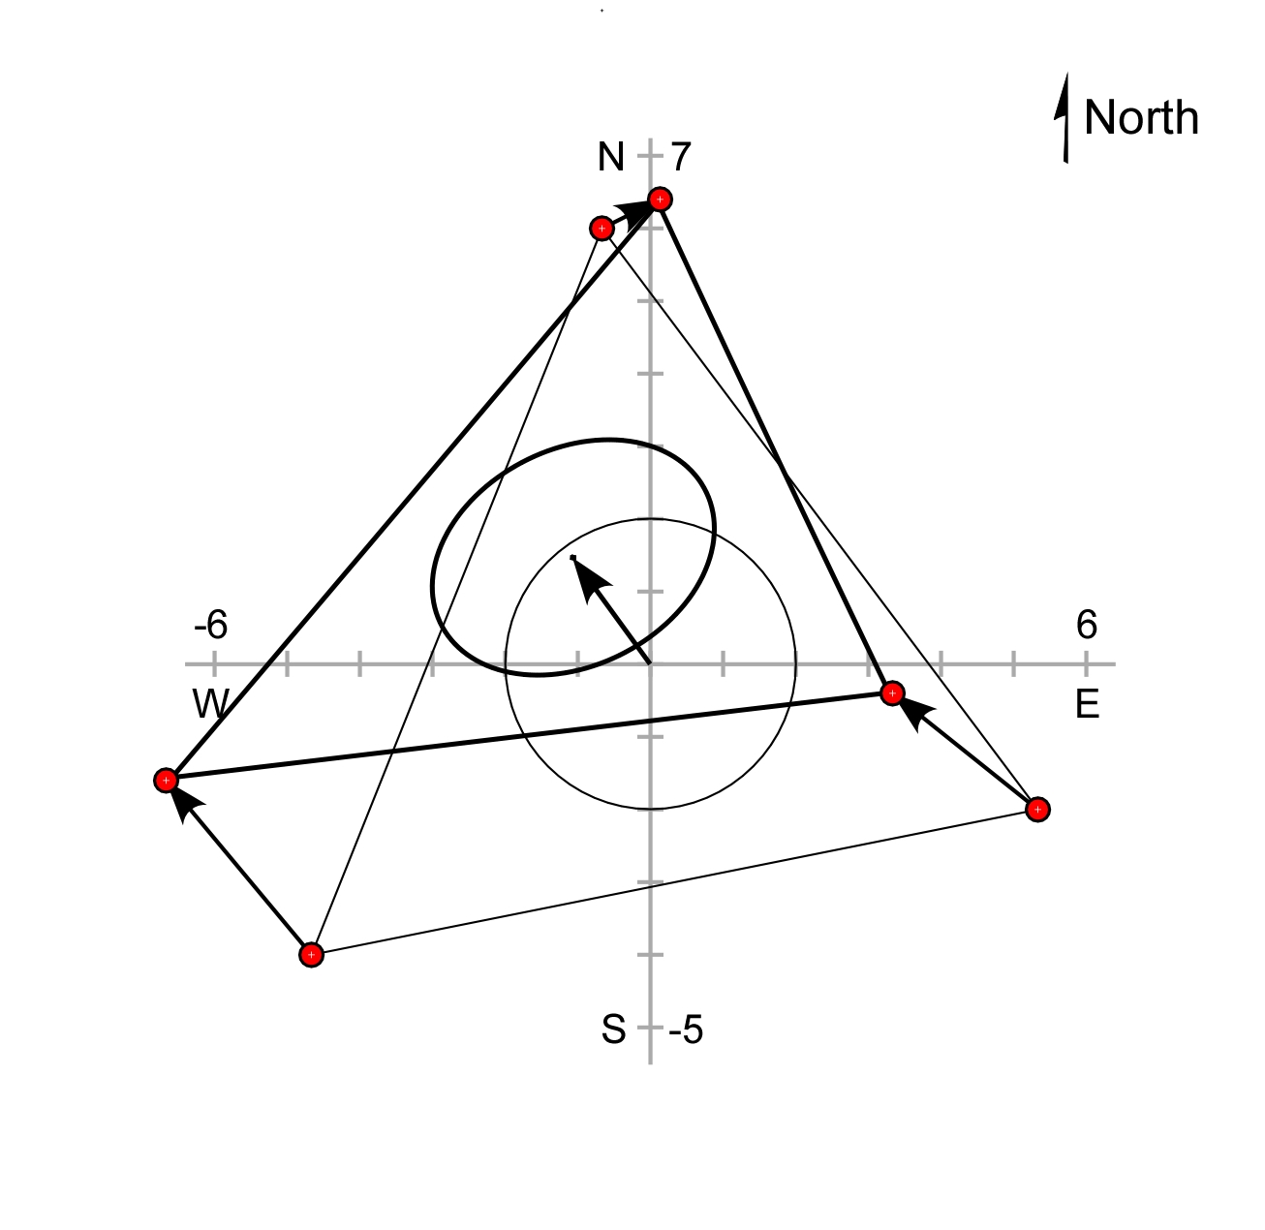
Strain rates from GNSS
The triangle deforms as it moves. The vector from the centroid of the undeformed triangle to the centroid of the deformed triangle is the same as the translation vector.

Slide 24
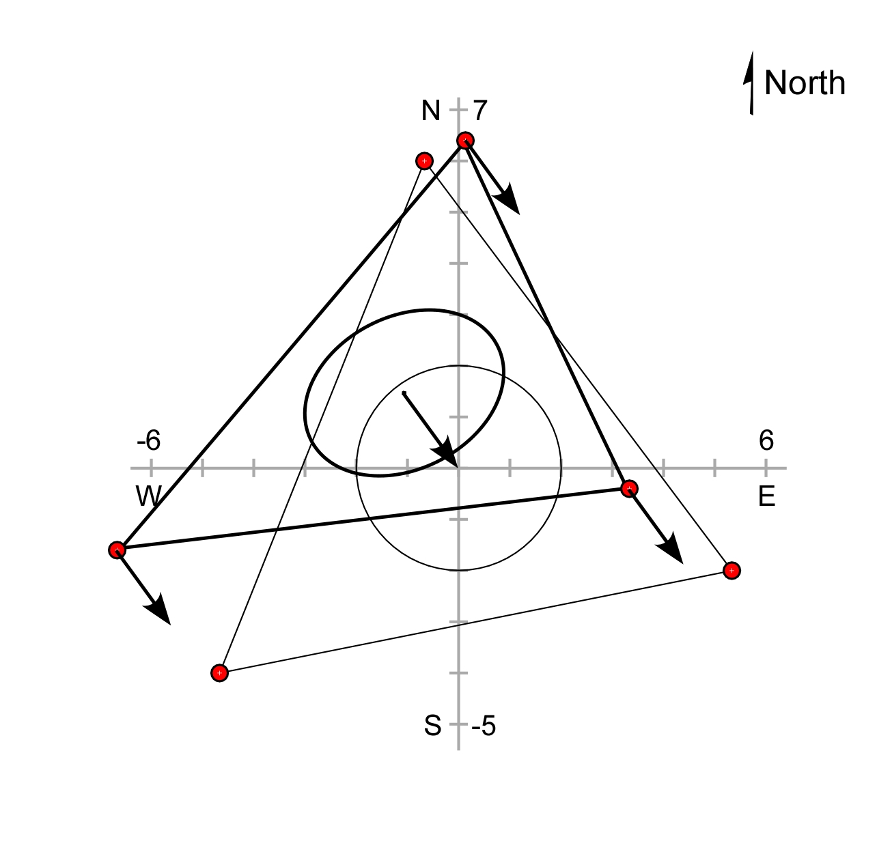
Strain rates from GNSS
Subtracting the translation vector from the site velocities brings the two triangle centroids together.

Slide 25
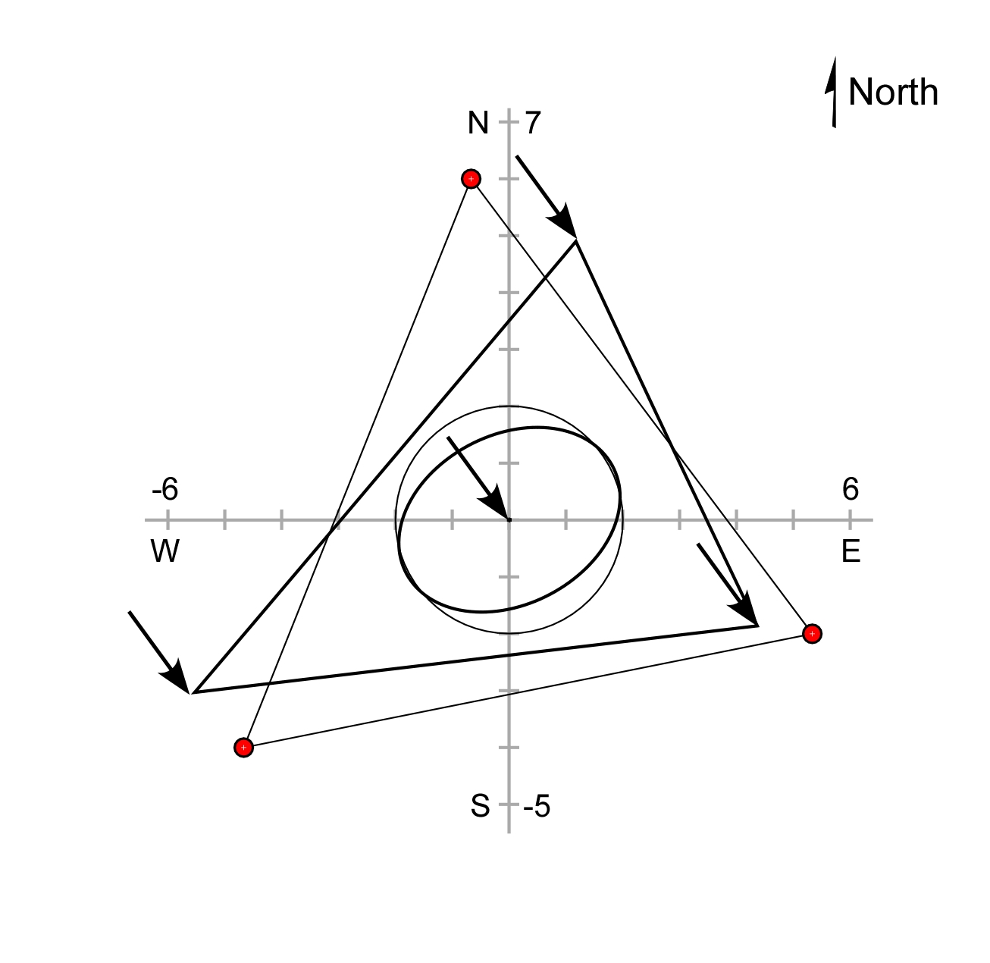
Strain rates from GNSS
Subtracting the translation vector from the site velocities brings the two triangle centroids together.

Slide 26
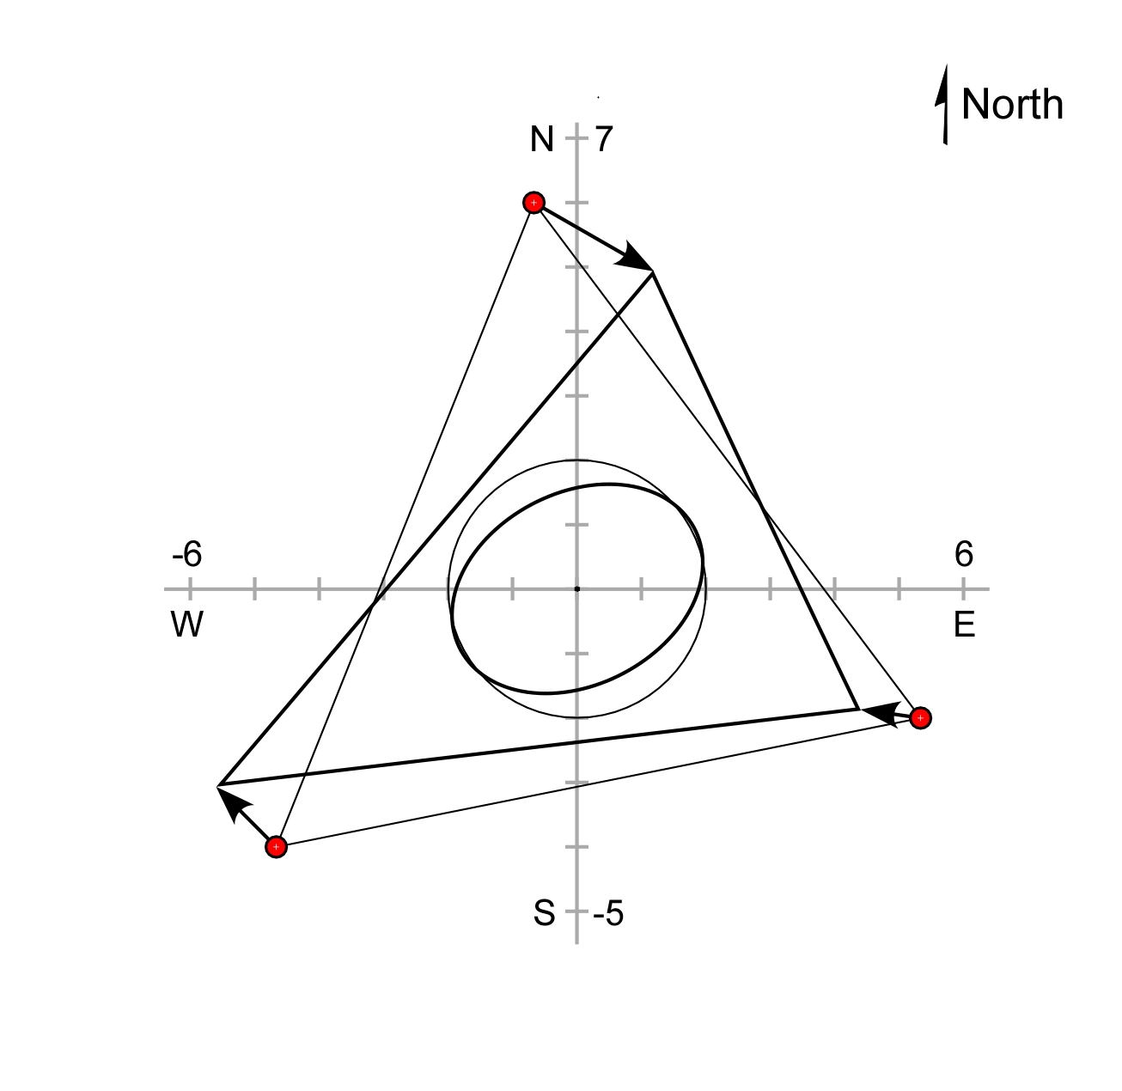
Strain rates from GNSS
The total site velocities minus the translation vector yields the site vectors associated with the change in shape of the triangle.

Slide 27
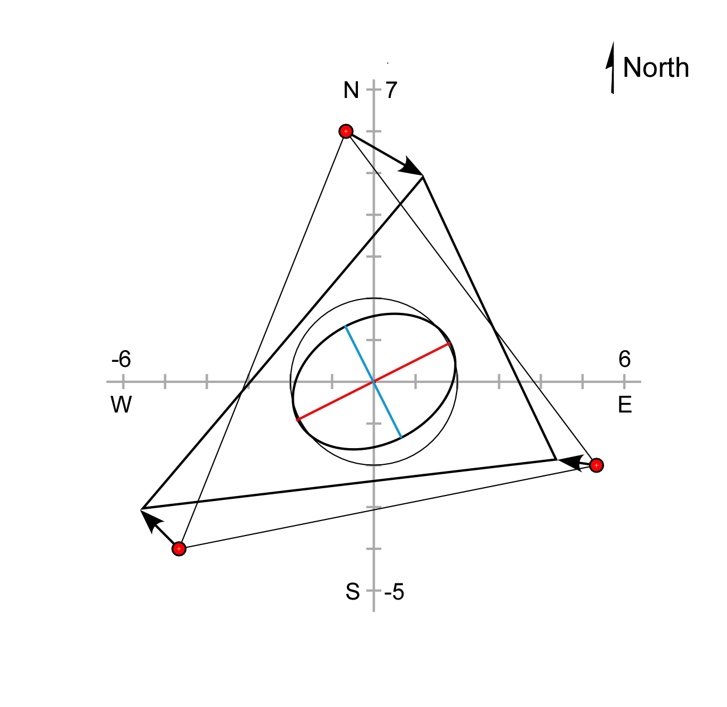
Strain rates from GNSS
The red line is the major axis of the strain ellipse, and the blue line is the minor axis

Slide 28
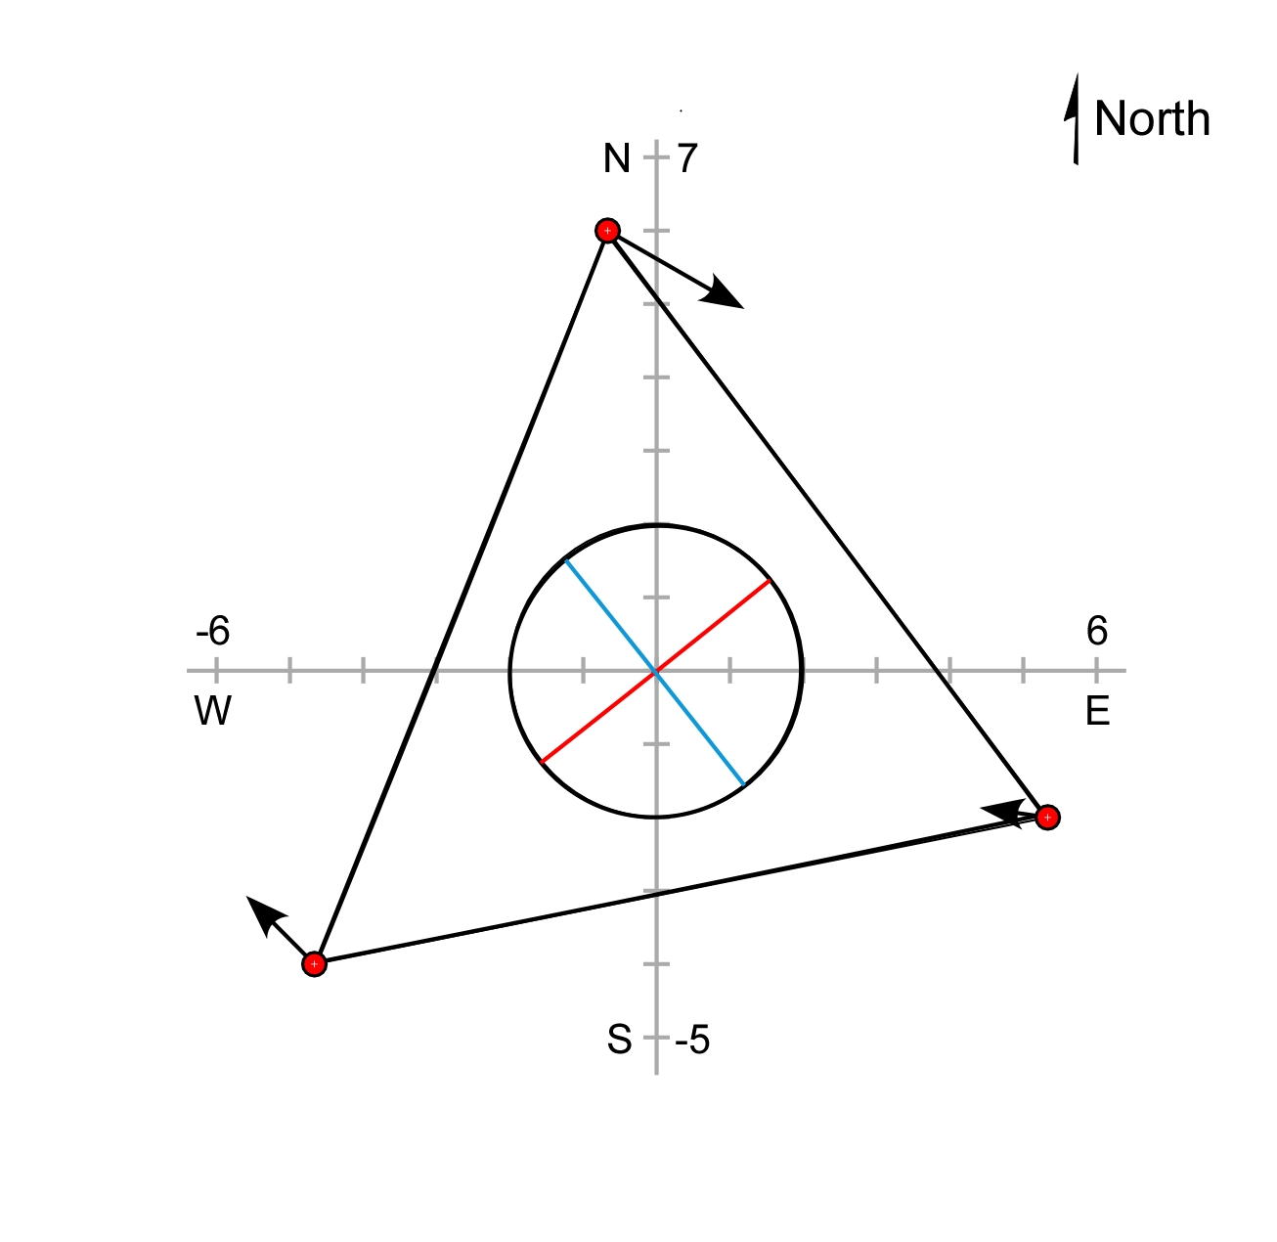
Strain rates from GNSS
The ellipse axes remain perpendicular to each other when the strain is reversed.

Slide 29
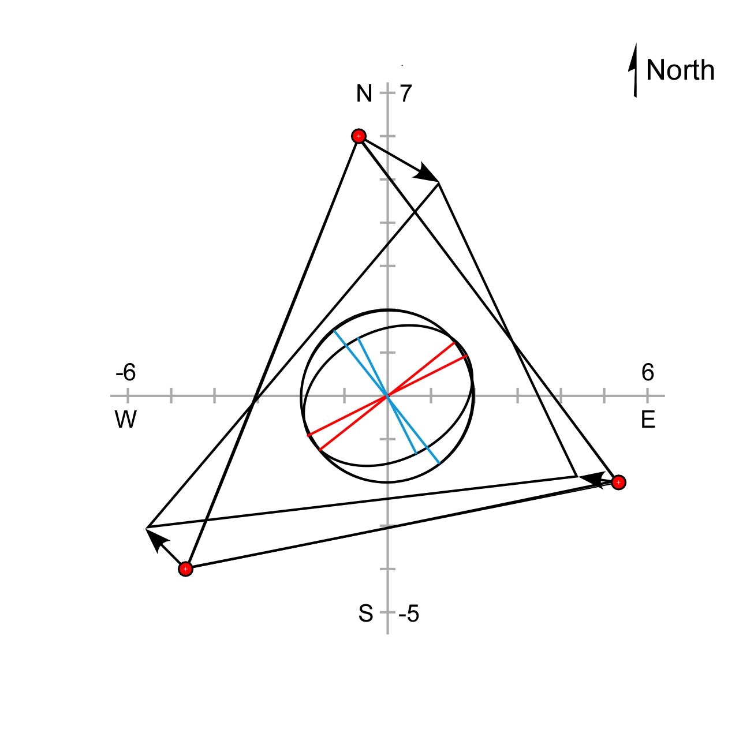
Strain rates from GNSS

Slide 30
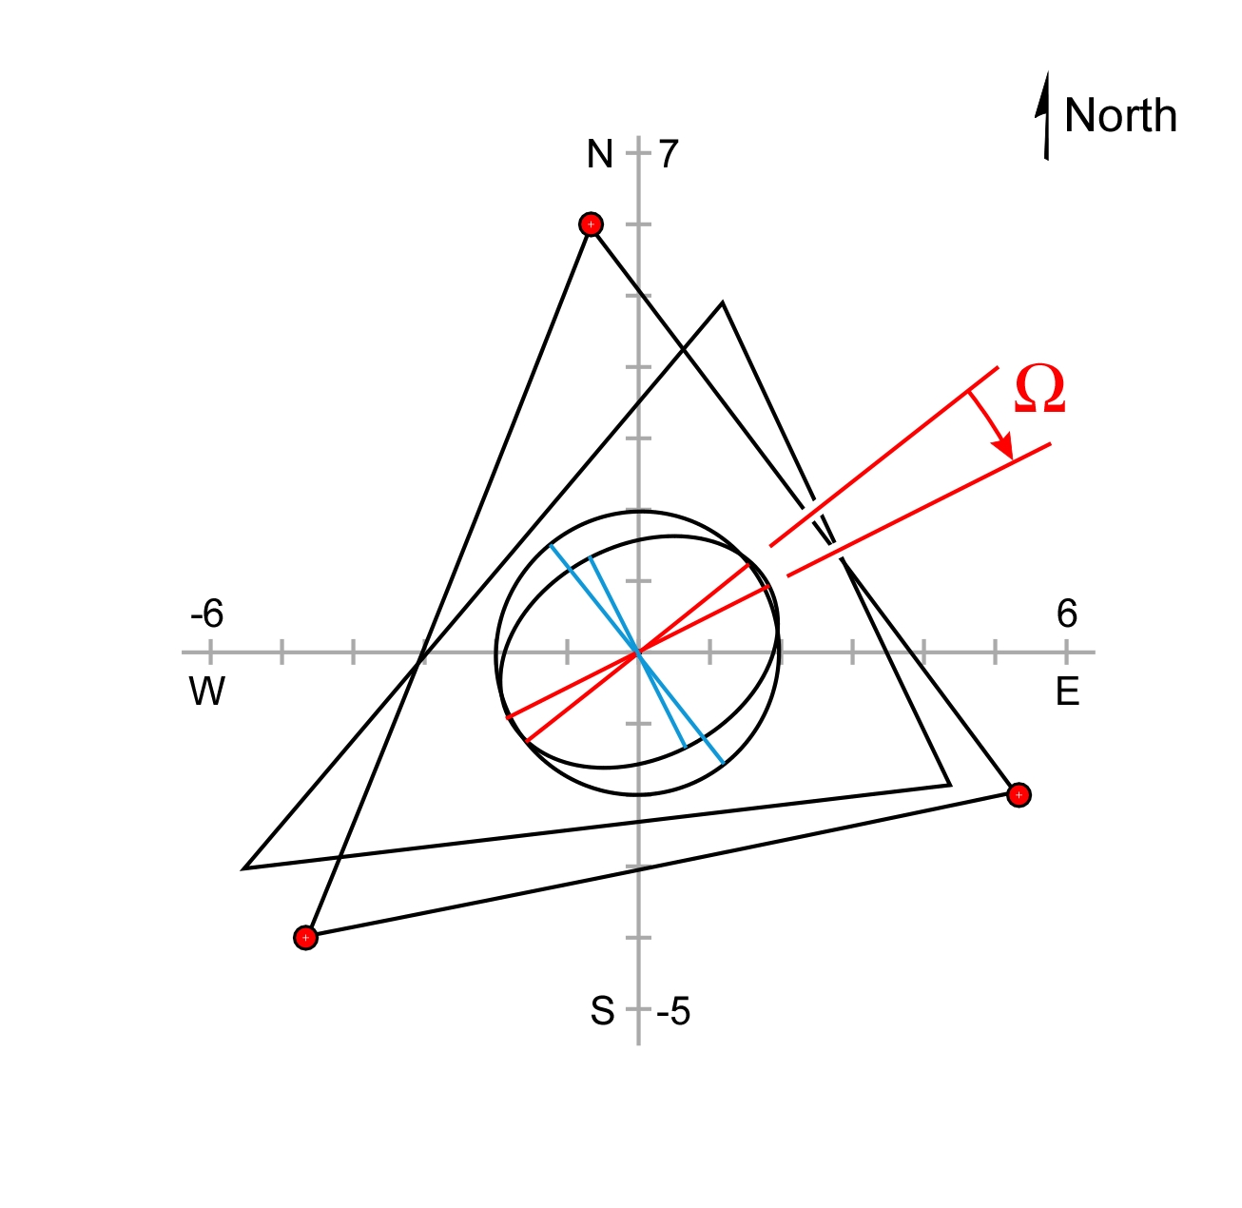
Strain rates from GNSS
The rotational component of strain is indicated by the angular change in the orientation of the red lines.

Slide 31
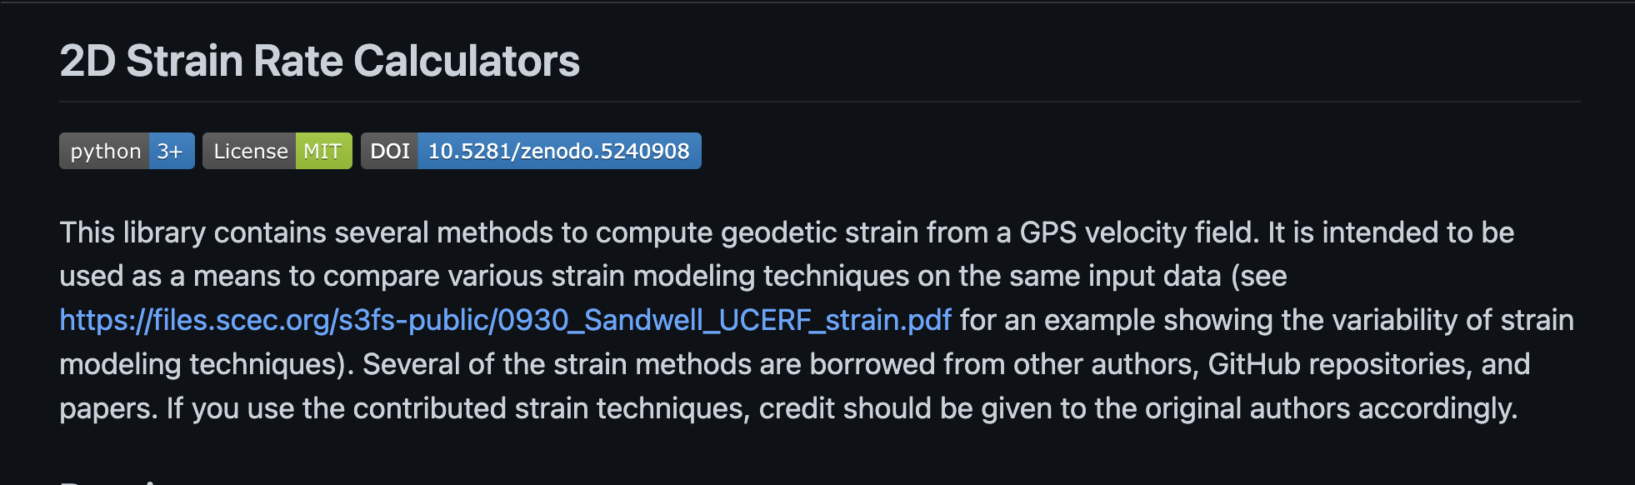
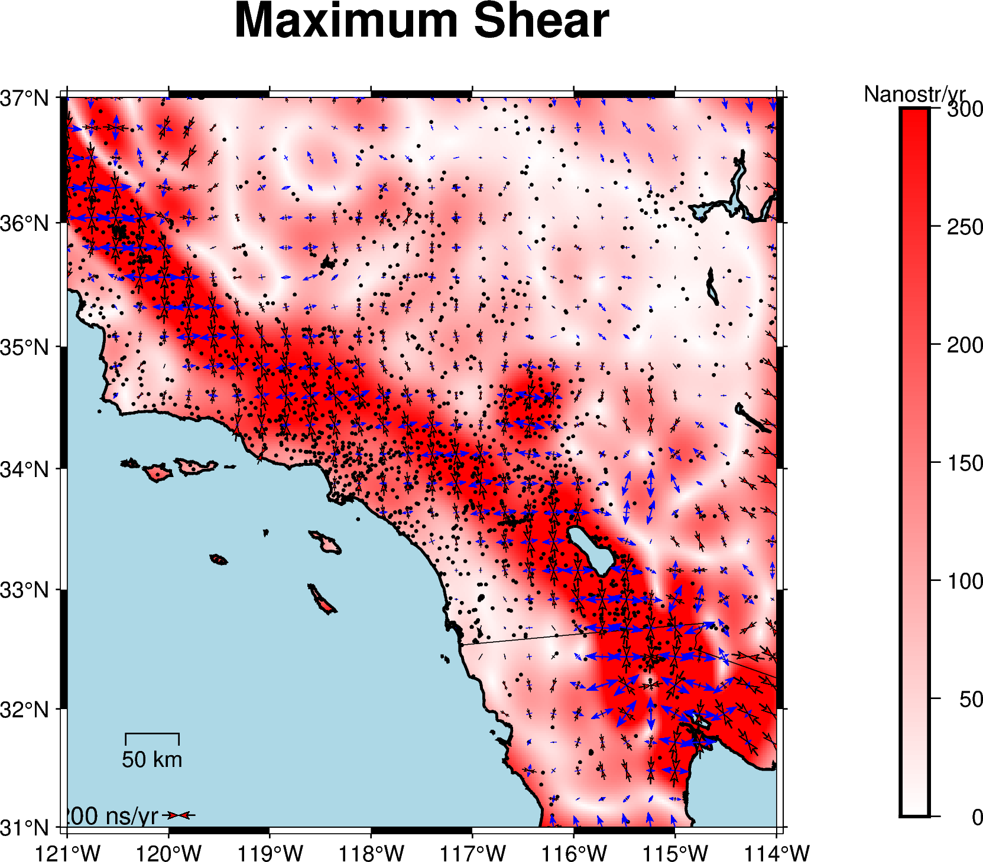
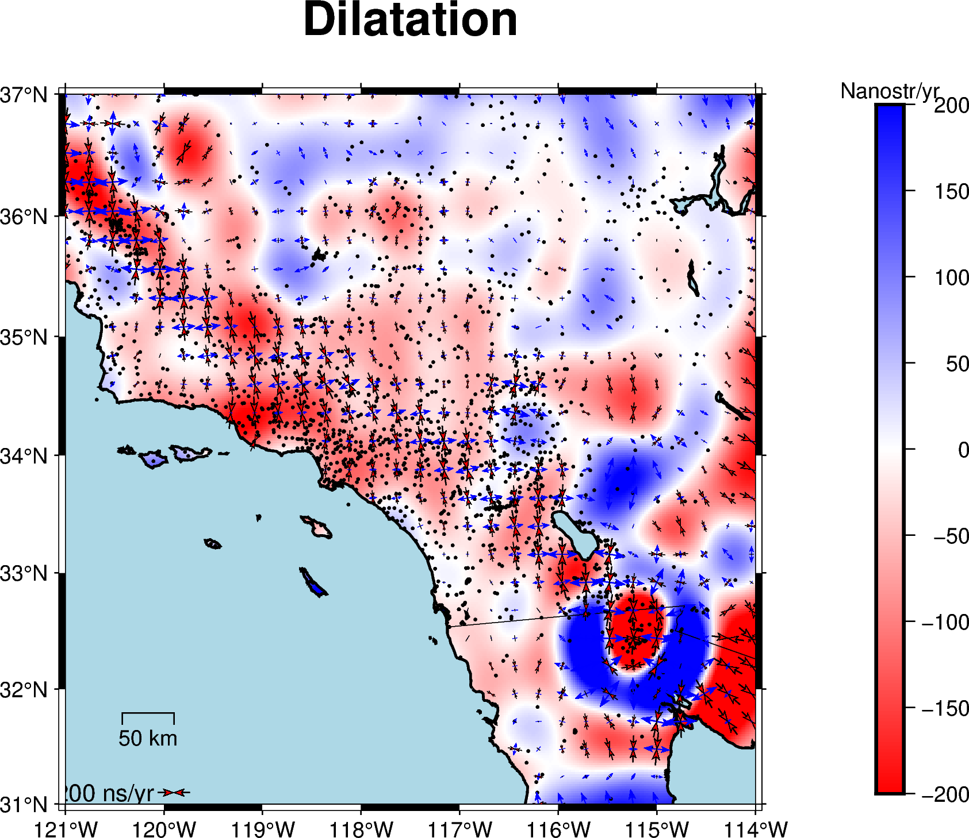
Strain_2D: Python strain-rate calculator
https://github.com/kmaterna/Strain_2D/

Slide 32
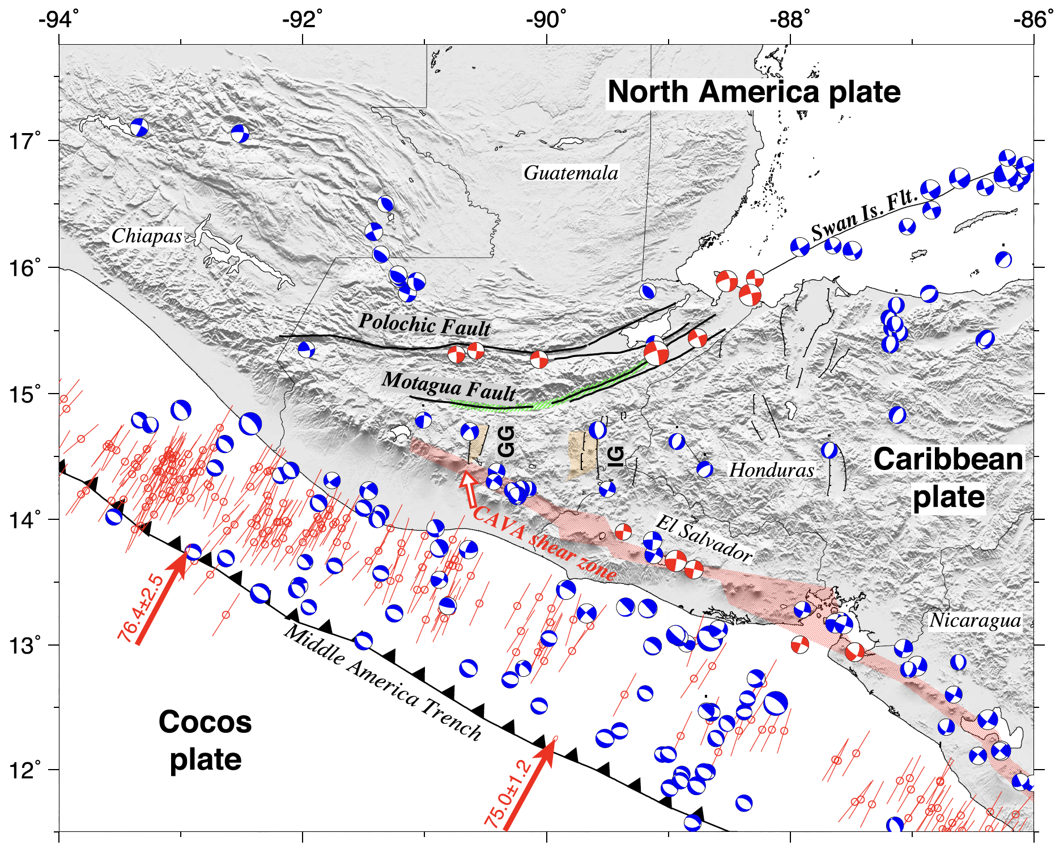
Guatemala tectonics
Subduction zone-related seismicity
Right-lateral strike-slip motion along the Jalpatagua fault and volcanic system
Normal faulting in the western Caribbean plate up to the triple junction
Left-lateral strike-slip faulting on the PMFS
Ellis et al., 2019

Slide 33
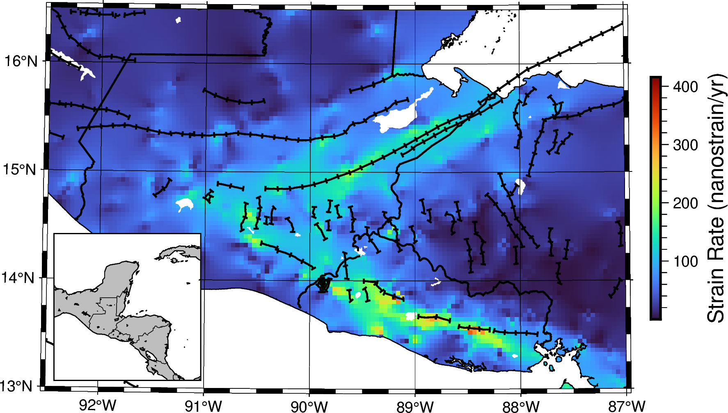
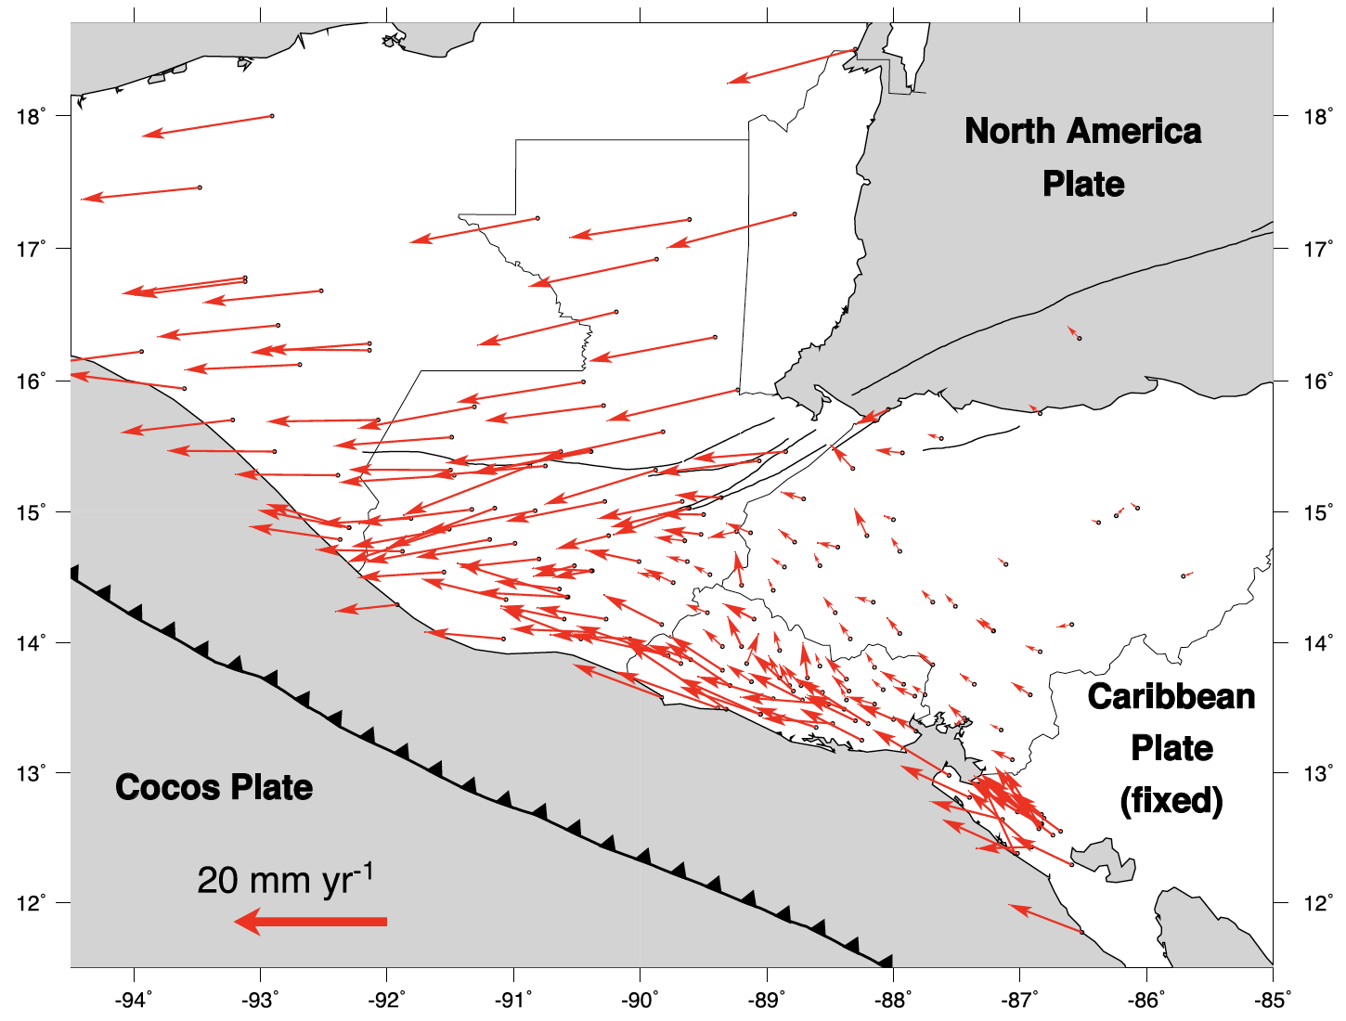

What information can be gleaned from geodesy?
Strain rate estimated using the gpsgridder (Sandwell and Wessel, 2016) method
Notes:
The velocity field from Ellis et al., does not take viscoelastic effects following the 1976 earthquake into account! Could be biasing the velocity field.

Slide 34
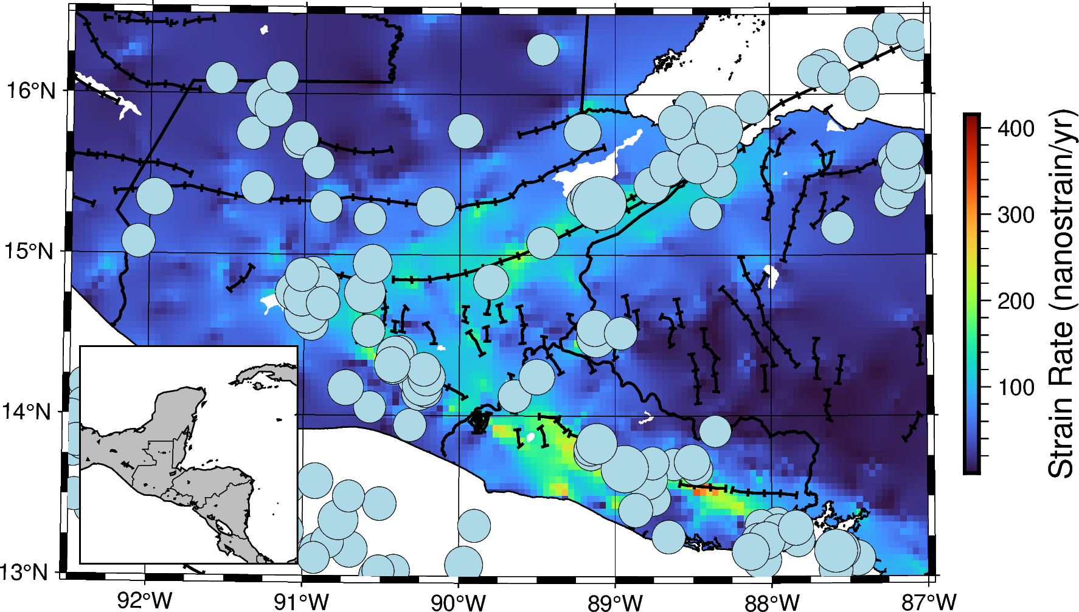
Strain rate from GNSS identifies active faults,
diffuse strain across PMFS
Seismicity rates - mostly proportional to strain rates

Slide 35
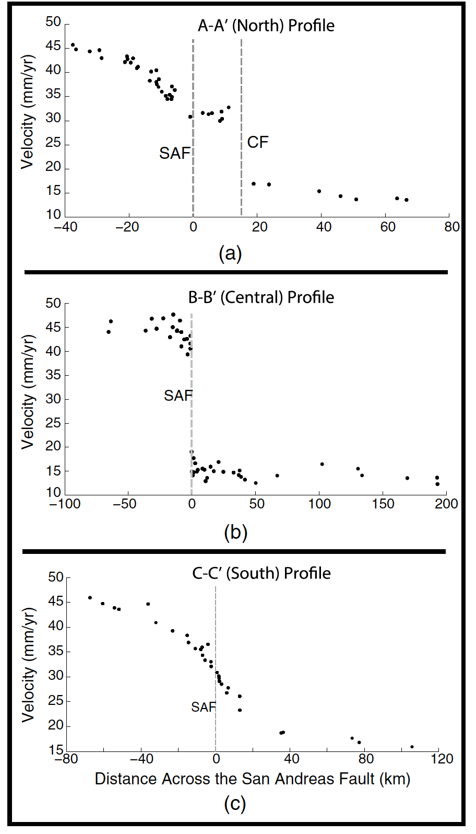
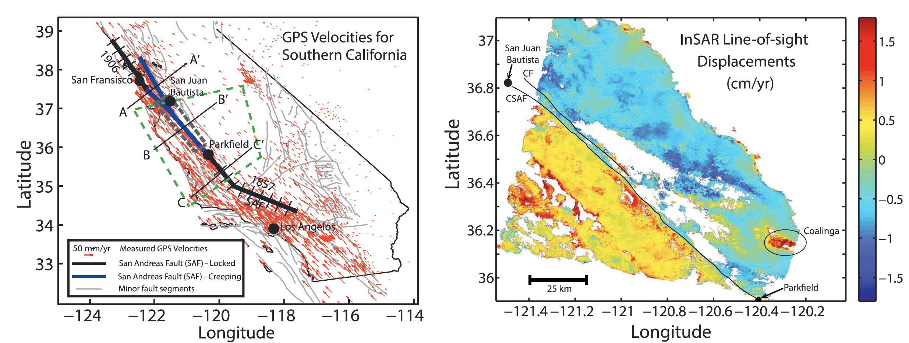
Central San Andreas Fault

Slide 36
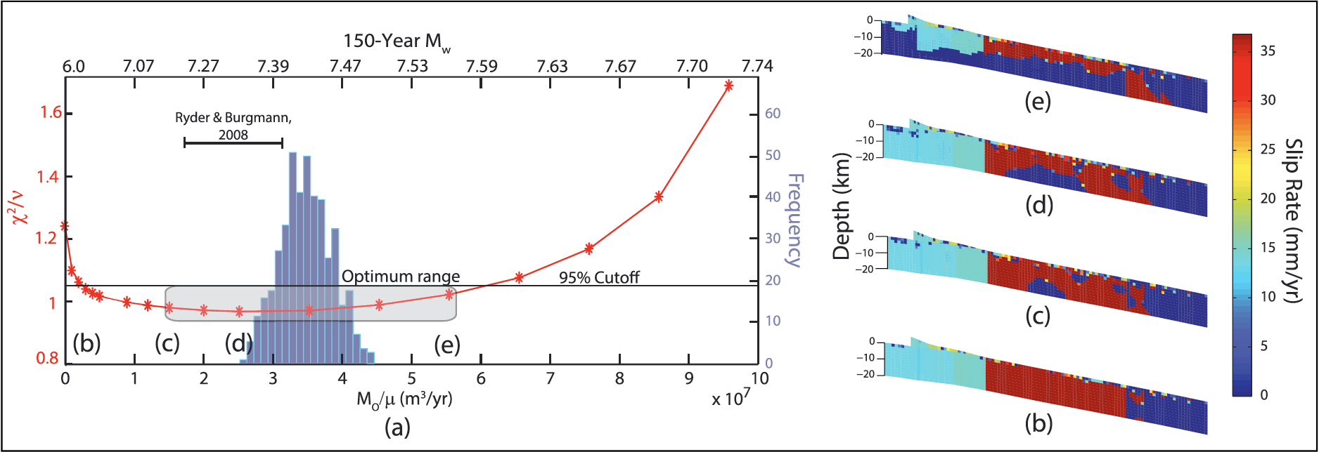
Central San Andreas Fault
Requires mathematical model to relate fault slip to surface strain
observations

Slide 37
Slow Slip Events (SSEs)
Like earthquakes, but slower

Slide 38

Earthquake Cycle Processes: Slow-slip events (SSEs)
Interseismic loading
Interseismic surface deformation
Slow Slip Events (aseismic)
Earthquake (co & post seismic)
?
Slow release of energy
in slow slip events
Modified from Atwater

Slide 39

Slow slip Events (SSEs) occur in Guerrero Mexico every 3-4 years
Slow-slip events are like earthquake, but occur over days to months
They occur on subduction zones between up-dip, large, locked regions of the crust and down-dip steady slip
Geodetic data measure surface displacements from SSEs
Ito et al., 2007
Radiguet et al., 2012

Slide 40
Why study Slow Slip Events?
Scenario 1:
Slow slip enters seismogenic zone
Release of stress in locked portion
Delays next earthquake?
Slow slip in
seismogenic zone
Scenario 2:
Slow slip downdip of seismogenic zone
Increase of stress in locked portion
Triggers next earthquake?
Increased likelihood of earthquake?
Slow slip just down dip
seismogenic zone
Modified from Atwater

Slide 41

Slow slip Events (SSEs) Around the World
Long-term 2cm over 2 years
Short-term 2mm over 5 days
1cm over 10 days
Figure from Rubinstein et al. 2010
2cm over month

Slide 42

Slow slip Events (SSEs) Around the World
GNSS Station CAYA
Long-term 2cm over 2 years
Short-term 2mm over 5 days
1cm over 10 days
SSE
Figure from Rubinstein et al. 2010
2cm over month
5cm over year
8 mm over month
Modified from David Bekaert

Slide 43

Slow slip Events (SSEs) occur in Guerrero Mexico every 3-4 years
Q. What is the earthquake hazard in the “gap” region?
Slow-slip events are like earthquakes, but occur over days to months
There is a “gap” in the Guerrero region where SSEs occur, no historic earthquake since at least 1911
The most recent event began around July 2017 and continued until sometime in 2018
After the SSE started, three large regional earthquakes occurred:
September 11, 2017 near Puebla and Mexico City
September 18, 2017 Chiapas
February 16, 2018 near Oaxaca

Slide 44
Slow slip Events (SSEs) occur in Guerrero Mexico every 3-4 years
Slow-slip events are like earthquakes, but occur over days to months
There is a “gap” in the Guerrero region where SSEs occur, no historic earthquake since at least 1911
The most recent event began around July 2017 and continued until sometime in 2018
After the SSE started, three large regional earthquakes occurred:
September 11, 2017 near Puebla and Mexico City
September 18, 2017 Chiapas
February 16, 2018 near Oaxaca
The SSE in the Guerrero region typically shows 5-6 cm of peak displacement at the surface

Slide 45

Observations: GNSS and ALOS-2 InSAR
GNSS
30 GNSS stations from a local network in Guerrero processed by Alex Gonzalez-Ortega
Supplemented by 27 stations processed by UNR (Blewitt et al., 2018)
ALOS-2 InSAR
3 descending tracks with data starting in 2015 obtained from JAXA under RA4 and 5 proposals
~30 scenes each track
SSE
2018 Oaxaca Eq
A
A’
B
B’

Slide 46
Comparing GNSS and InSAR
Track 155
Track 153
Track 152
10 cm
Step
-10 cm

Slide 47
Offset Estimation
We down-sample each track by random sampling uniformly in space to 3-5k points each
We fit a linear trend, offset, and step function to each pixel’s time-series
The step function spans 2017.3-2018.5 and encompasses the 2017/18 SSE and the regional earthquakes
V_{inter-SSE}
Cumulative displacement
d_{SSE}
a_{m}
t_{master}
t_{SSE}
Time, t
Modified from David Bekaert
Notes:
25 km square dislocation patches.

Slide 48


Offset Estimation
We down-sample each track by random sampling uniformly in space to 3-5k points each
We fit a linear trend, offset, and step function to each pixel’s time-series
The step function spans 2017.3-2018.5 and encompasses the 2017/18 SSE and the regional earthquakes
*Removed coseismic offsets from Chiapas eq prior to step fcn
Notes:
25 km square dislocation patches.

Slide 49
Offset Estimation
We down-sample each track by random sampling uniformly in space to 3-5k points each
We fit a linear trend, offset, and step function to each pixel’s time-series
The step function spans 2017.3-2018.5 and encompasses the 2017/18 SSE and the regional earthquakes
V_{inter-SSE}
d_{SSE}
a_{m}
V_{inter-SSE}
d_{SSE}
a_{m}
Notes:
25 km square dislocation patches.

Slide 50
We use the bootstrap to estimate a trend, step, and residual master for each track
Residual Master (a_{m})
Trend
Step
Bootstrapping to get distributions on each parameter
Distribution variances used to estimate the data covariance using an exponential model
The trend and step function are anti-correlated in the least-squares estimation, and lead to systematic errors (ramps)
Bootstrap Estimate
Trend
Cumulative displacement
Step
a_{m}
Track D153
t_{master}
t_{SSE}
Time, t
Notes:
25 km square dislocation patches.

Slide 51
We use the bootstrap to estimate a trend, step, and residual master for each track
Residual Master (a_{m})
Trend
Step
Bootstrapping to get distributions on each parameter
Distribution variances used to estimate the data covariance using an exponential model
The trend and step function are anti-correlated in the least-squares estimation, and lead to systematic errors (ramps)
Bootstrap Estimate
Bootstrap Uncertainty
Track D153
Notes:
25 km square dislocation patches.

Slide 52
Use the step estimate to solve for slip on the fault
Track 155
Track 153
Track 152
10 cm
Step
-10 cm

Slide 53

We fit cumulative offsets from the 2017/18 SSE and regional earthquakes
Model Assumptions:
Discrete fault patches in an elastic half-space
GPS constrains InSAR long wavelength
Errors are fully described
Model parameters:
Slip magnitude in the up-dip direction
InSAR plane to match long-wavelength GNSS
Hyperparameters
Smoothness parameter
Bekaert et al., 2015b, JGR
Classic Inverse Problem
Given a set of observations, estimate the unknown sources behind them
For elasticity is a linear problem
For tectonic problems, typically “under-constrained” and unknown model errors
Notes:
25 km square dislocation patches.

Slide 54


We fit cumulative offsets from the 2017/18 SSE and regional earthquakes
Model Assumptions:
Discrete fault patches in an elastic half-space
GPS constrains InSAR long wavelength
Errors are fully described
Model parameters:
Slip magnitude in the up-dip direction
InSAR plane to match long-wavelength GNSS
Hyperparameters
Smoothness parameter
Bekaert et al., 2015b, JGR
Diagonal of the model resolution matrix
GNSS only (top) and GNSS + InSAR (bottom)
1 – Well resolved
0 – Not resolved
Notes:
25 km square dislocation patches.

Slide 55



GNSS-only slip solution
We solve the best-fitting slip model:
Using the mean smoothness parameter from the MCMC inversion
Regularizing the solution with both minimum-norm and minimum-roughness terms
Slip patches with MCMC distributions within 1σ of zero are set to zero
GNSS Residuals

Slide 56



InSAR + GNSS, full covariance slip and moment
We estimate the data covariance by fitting an exponential variogram model to the bootstrap uncertainties
Modeled
Residauls
GNSS Residuals
InSAR Residuals

Slide 57

Aseismic fault slip occurs in regions around areas of seismicity
The SSE occurs down-dip of small earthquakes in the gap region
Oaxaca afterslip occurs both up-dip and down-dip of an area with several M_{W} 7+ earthquakes
Significant afterslip from the Oaxaca earthquake appears to occur all the way to the trench
What is the interplay between aseismic slip and earthquakes (fast seismic slip)?
Fault model + Eqs M_{W} 5+ for last 100 years from COMCAT

Slide 58
Moment bounding
Like earthquakes, but slower

Slide 59


Approach: Moment Deficit Rate (MDR)
Is a direct estimate of earthquake potential
Is a robust, scalar parameter that can be uniquely solved for without smoothing
Can integrate over many non-unique slip deficit models
Notes:
We know that we can never know slip at a point, but we can bound the integral over the entire fault

Slide 60

Estimating the current MDR in Southern California
Johnson, 2013
CMM4 (Field et al., 2013)

Slide 61

Notes:
Build up slide more

Slide 62



Slide 63




Fault-Free Method: Integrating Surface Strain Rates
Advantage: Get strains, MDR directly from geodetic data with uncertainties
Disadvantages: cannot relate MDR to specific faults, non-unique mapping from strain to MDR, need locking depth specified

Slide 64

Fault-Free Method: Integrating Strain Rates
Advantage: can get a direct estimate from geodetic data without using faults
Disadvantages: cannot relate MDR to specific faults, non-unique mapping from strain to MDR, need locking depth specified

Slide 65
Conclusions
Analysis of tectonic deformation with GNSS + InSAR can:
reduce decorrelation noise with L-band RADAR
reduce ionosphere and troposphere noise using Atmospheric corrections and Time-series analysis
minimize residual troposphere impact using full covariance estimation and joint inversion with GNSS
account for noisy observations and imperfect model resolution through uncertainty quantification

Slide 66


InSAR Time-series

Slide 67

InSAR Time-series

